Slide 1
Opening slide – BWC logo

Slide 2
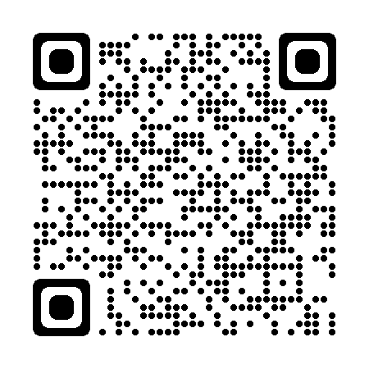
June safety council update
Safety council
David Meronk
Safety Consultant
Toledo service office
419-564-1101
David.M.15@bwc.Ohio.Gov
bwc.ohio.gov

Slide 3
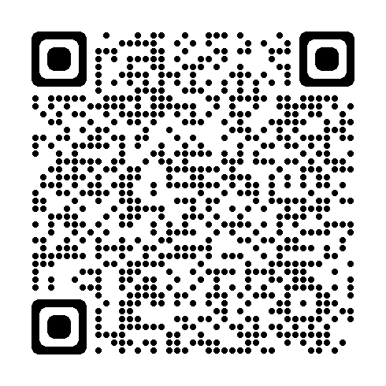
Monthly learning June
June 2 - First aid in the workplace
Del-Co Water Co. Wolf Event Center 201, Delaware, OH
June 9 - Violence in the workplace
Bowling Green State University, Perrysburg, OH
  June 9 - Ergonomics: Basic principles
  Del-Co Water Co. Wolf Event Center 201,
  Delaware, OH
bwclearningcenter.com
In-person classes and virtual training classes (VTC) qualify for Safety Council rebate external training credits.
Notes:
*Required slide

Slide 4
Monthly learning June – (continued)
June 16 - Electrical basics
Edison State Community College, Piqua, OH
  June 18 - First aid in the workplace
  Canton Service Office
bwclearningcenter.com
In-person classes and virtual training classes (VTC) qualify for Safety Council rebate external training credits.
Notes:
*Required slide

Slide 5
Monthly learning July
July –No in-person classroom training in July
bwclearningcenter.com
In-person classes and virtual training classes (VTC) qualify for Safety Council rebate external training credits.
Notes:
*Required slide
Please ensure you emphasize no in person training for the month of July.

Slide 6
Virtual learning June
June 3-4 - Electrical safety in the workplace through insight and implementation of NFPA 70E
June 10 - Emergency preparedness planning half-day workshop
June 17 - Bloodborne pathogens
June 30 - Lockout/tagout and safety-related work practices
bwclearningcenter.com
In-person classes and virtual training classes (VTC) qualify for Safety Council rebate external training credits.
Notes:
*Required slide

Slide 7
Virtual learning July
July - No virtual training in July
bwclearningcenter.com
In-person classes and virtual training classes (VTC) qualify for Safety Council rebate external training credits.
Notes:
*Required slide
Please ensure you emphasize no virtual training for the month of July.

Slide 8
Webinars – June and July
June 4 - Working in a confined space? What you should know before you break the plane
July – No webinars scheduled for July
bwclearningcenter.com
Webinars do not qualify for Safety Council rebate external training credits.
Notes:
*Required slide
No scheduled webinars in July.

Slide 9
Private employer important dates – June and July
June 1 - PA last day for individual retro settlements (close out year for 10-year annual evaluation)
June 22 - PA PY 2026 first installment due
July 1 - PA policy year begins
July 1 - PA Early Payment Discount due date, employer must pay the full PY 2026 estimated annual premium
Notes:
*Required slide

Slide 10
Private employer important dates – June and July – (continued)
July 1 - PA Payroll true-up period for policy year 2025 begins
July 15 - PA deadline to file settlement application (C-240) to impact EM
July 31 - PA .99 EM Construction Cap deadline to opt out (U-108) or submit Safety Management Self-Assessment (SH-26)
July 31 - PA Substance Use Prevention and Recovery (SUPR) Program, BWC recommends the accident analysis training for the initial program year be completed by this date. New supervisors must complete within 60 days of becoming a supervisor
Notes:
*Required slide

Slide 11
Public employer important dates – June and July
June - No important public employer deadline dates
July 31 - PEC Deductible Program application deadline for 1/1/2027 start date
July 31 - PEC Group Retrospective application deadline for 1/1/2027 start date
July 31 - PEC Claim Impact Reduction Program (CIRP) application deadline for 1/1/2027 start date (initial year applicants)
July 31 - PEC Retrospective Rating application deadline for 1/1/2027 start date
Notes:
*Required slide
No specific public employer deadline dates to mention.

Slide 12
Electrical Safety Basics
Notes:
* Optional slide

Slide 13
Electrical safety basics overview
Electrical risks exist even at low voltage
Common injuries include shocks, burns, and falls
Most fatalities occur in non-electrical jobs ( 140-150 deaths in 2023)
Water and metal increase risk
Proper training and awareness are critical
Provide the right equipment and PPE
Notes:
* Optional slide
Here are your objectives for today’s discussion.
Even Low voltage can have significant injuries.
Electrical burns are very damaging to the nerves, and muscles
Data compiled by the Electrical Safety Foundation International show that a large majority of electrical fatalities happen to workers in occupations that are not classified as electrical trades, so “most electrical fatalities occur in non‑electrical jobs” is supported by recent analyses. The Census of Fatal Occupational Injuries counted about 140–150 electrical exposure deaths in 2023.
Water and metal both increase electrical‑shock risk because water lowers skin and surface resistance, and metal provides a low‑resistance path to ground; together they greatly raise the chance that an energized source will produce a harmful current through a person.
Electrical training and properly PPE are essential — training prevents unsafe work practices and PPE reduces injury severity., together they are core requirements of effective guidance for protecting workers from shock, arc flash, and burns.

Slide 14
OSHA data 2011-2023
Contact with or exposure to electricity continues to be one of the leading causes of workplace fatalities and injuries
1,940 workplace electrical fatalities between 2011 – 2023
5.6% of all workplace fatalities are caused by electricity
74% of fatalities occur in non-electrical occupations
Notes:
* Optional slide
OSHA Data released 2024
https://www.esfi.org/workplace-safety/workplace-injury-fatality-statistics/
The Data underscores the need for better training, awareness, and safety protocols—not just for electricians, but for everyone who might encounter electrical systems.
It also suggests that many of these deaths could be prevented with proper lockout/tagout procedures, PPE, and hazard recognition.

Slide 15
Types of electrical hazards
  Severity and effects of an electrical shock depend on a number of factors
    Pathway through the body
    Amount of current
    Length of time of the exposure
    Whether skin is wet or dry
  Water
    Great conductor
    Allows current to flow more easily in wet conditions and through wet skin
Notes:
* Optional slide
The severity and effects of an electrical shock depend on several factors, such as the pathway through the body, the amount of current, the length of time of the exposure, and whether the skin is wet or dry.
Water is a great conductor of electricity, allowing current to flow more easily in wet conditions and through wet skin.

Slide 16
Electrical injuries
There are four main types of electrical injuries:
  Direct:
    Electrocution (death due to electrical shock)
    Electrical shock
    Burns
  Indirect:
    Falls
Notes:
* Optional slide
When an electrical shock enters the body, it may produce different types of injuries.
Electrocution results in internal and external injury to body parts or the entire body – often resulting in death.
Shock or a “jolt” of electricity in part of the body may be temporarily paralyzed, may cause loss of grip or stability.
A person may also involuntarily move because of receiving an electrical shock, resulting in a fall.
Internal or external burns may result from contact with electricity.

Slide 17
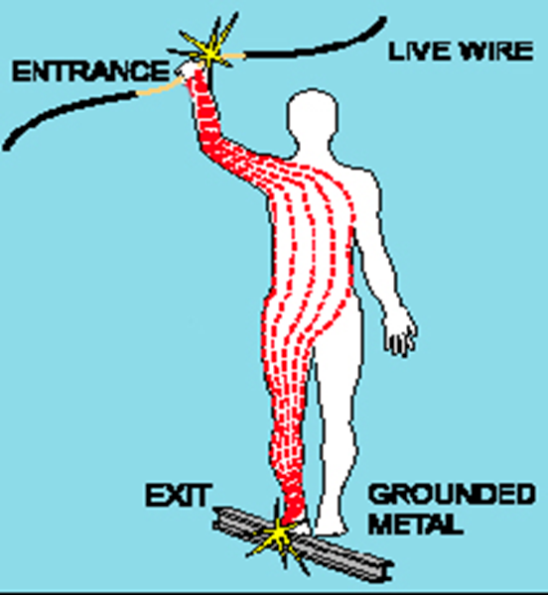
Shock severity
Severity of the shock depends on:
Path of current through the body
Amount of current flowing through the body (amps)
Duration of the shocking current through the body
LOW VOLTAGE DOES NOT MEAN LOW HAZARD
Image courtesy of OSHA
Notes:
* Optional slide
Other factors that may affect the severity of the shock are:
- The voltage of the current.
- The presence of moisture
- The general health of the person prior to the shock.
Low voltages can be extremely dangerous because: Path across heart, Duration/exposure, falls from ladders
The resistance of the body varies based on:
The amount of moisture on the skin (less moisture = more resistance)
The size of the area of contact (smaller area = more resistance)
The pressure applied to the contact point (less pressure = more resistance)
Muscular structure (less muscle = less resistance)

Slide 18
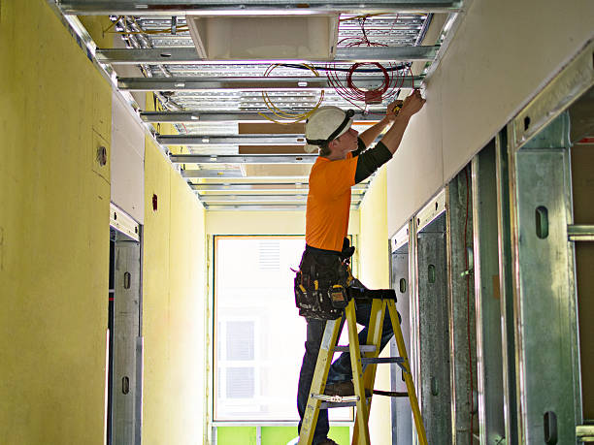
Falls
Electric shock can also cause indirect injuries
Workers in elevated locations who experience a shock may fall, resulting in serious injury or death
Source: NIOSH
Notes:
* Optional slide
Picture from NIOSH Electrical Safety Manual.
What is conductive in the picture? Wires, conduit, aluminum frame for drop ceiling. Ladder is fiberglass and not conductive.
If worker touches hot wire and any conductive surface, they will likely receive a shock. The shock may cause them to fall.

Slide 19
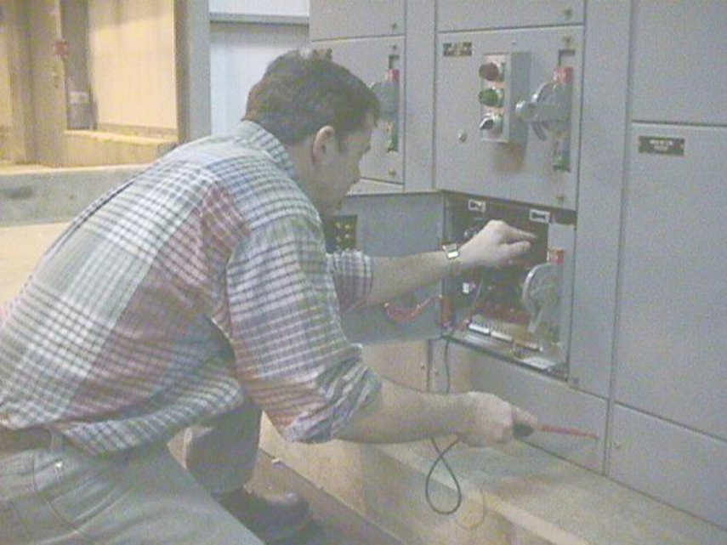
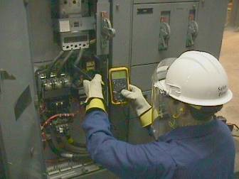
Safeguards for personnel protection: Personal protective equipment
Employer shall access and provide PPE appropriate for the magnitude and specific body parts for the exposure
Protective equipment shall be maintained in a safe, reliable condition and shall be periodically inspected or tested
Photographs courtesy of OSHA
Notes:
* Optional slide
Employees working in areas with the potential for electrical hazard exposure shall be provided appropriate PPE.
PPE required shall be determined prior to the task....ideally thru a Job Hazard Assessment or a pre-task evaluation.
OSHA 1910.335- Protective equipment shall be maintained in a safe, reliable condition and shall be periodically inspected or tested

Slide 20
Training requirements
Employees (qualified and unqualified) shall be trained in and familiar with the electrical safety work practices that pertain to their job assignments
The degree of training shall be determined by the risk to the employees
Training shall be of the classroom or on-the-job type
Notes:
* Optional slide
Qualified persons (e.g., electricians)
Unqualified persons (e.g., maintenance workers, machine operators) who may still be exposed to electrical hazards
Employees shall be trained in the safety related work practices that pertain to their job assignments; which means that the content of training for office workers would differ from the training to a machine operator.
Even though annual training is not explicitly required by OSHA, many employers choose to conduct it annually to:
Reinforce safety culture
Stay compliant with NFPA 70E (which recommends refresher training every 3 years)
Address changes in equipment or procedures.
Employee’s job duties change.
New equipment or hazards are introduced.
There is evidence that the employee has not retained the necessary knowledge or skills.

Slide 21

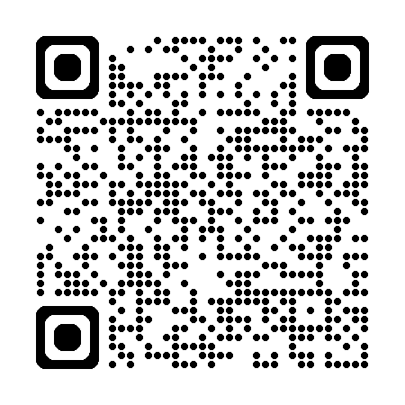
Office of safety services – We are here to help
On-site safety consultations
Workplace hazard assessments
Ergonomics and process safety reviews
Training and education courses
Grant opportunities for safety
equipment
Notes:
*Required slide – Always end slide show with call to action with OSS service offerings.

