Slide 1

Does Emotional Intelligence and Customer Service really matter in the workplace?
Avita Health System WorkWell
Jared Cass, OTR/L, CEAS I,II, TWD
Director of Occupational Medicine & Employee Health
jcass@avitahs.org
419-566-3888
Notes:
12
17

Slide 2

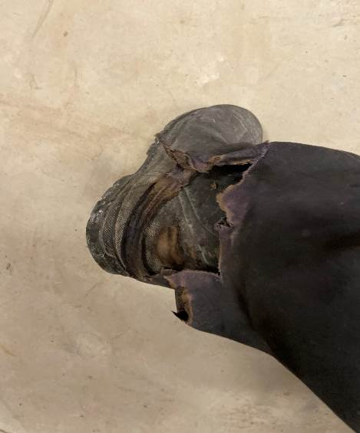
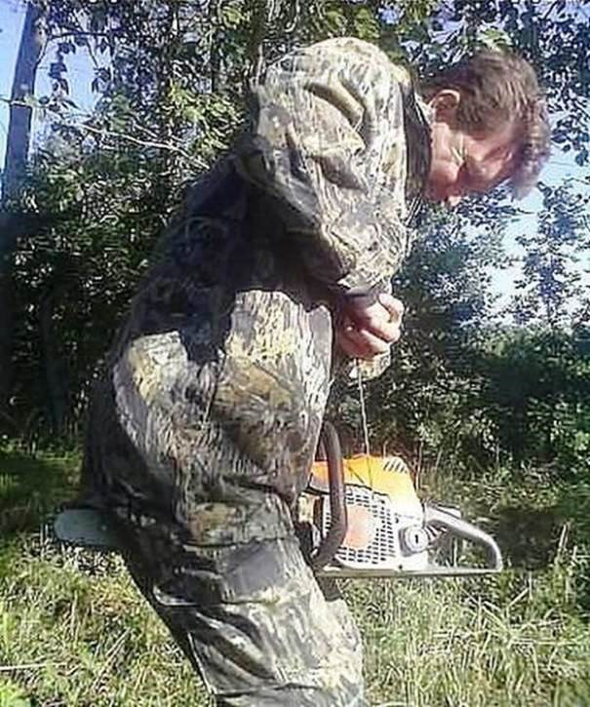

T or F
You should do what you feel is best for your employees?
The power of the Key

Slide 3
Is anyone in this room easily offended?
Abortion AR15
Taxes Joe Biden
Gender Neutrality Divorce
Spy Balloons Church
Donald Trump Ford/Chevy
Settle Down

Slide 4


The Get it On Button

Slide 5
How Old are You?
Where do you not want your employees going?
ER? You meant to say….. Emergency Department
What is your #1 business expense and who manages it?
HR? You meant to say…… Human Capital Management
How do you keep a pulse (human side) of your outcomes?
Customer Satisfaction? Surveys? Questionnaire?
Customer Loyalty? The Customer Experience?
T R E A T P E O P L E R I G H T

Slide 6
How Old are You?
Bed Rest (Employee)
Guidelines and return in X weeks (Provider)
Body Mechanics Training (Employee)
Ergonomics Training (Safety Professional)
Light Duty (BWC)
Transitional Work (BWC)
Emotional Intelligence (YOU)

Slide 7
iBehavior Modification
Please & Thank you & Throw in a “Why”
Take 5 Seconds – 90% of the time…..
Identify the trigger
MAKE A DECISION
Reverse Roles
Show concern
Clarify
Keep it Real

Slide 8
Scum Bags and the “O” Word
Preseneteeism
M Word
Entitlted….Lazy….Clueless
Really just means born between 1981 and 1996
O Word
Born before me

Slide 9
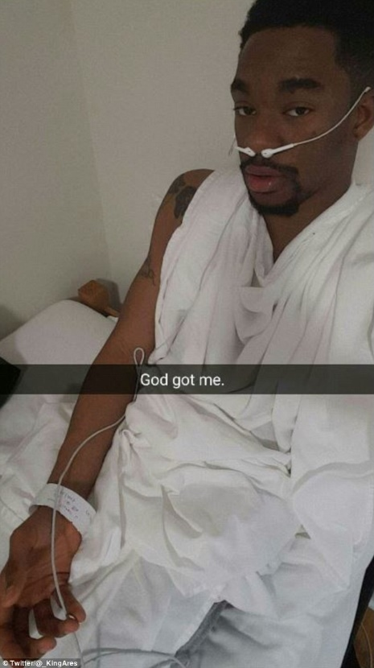
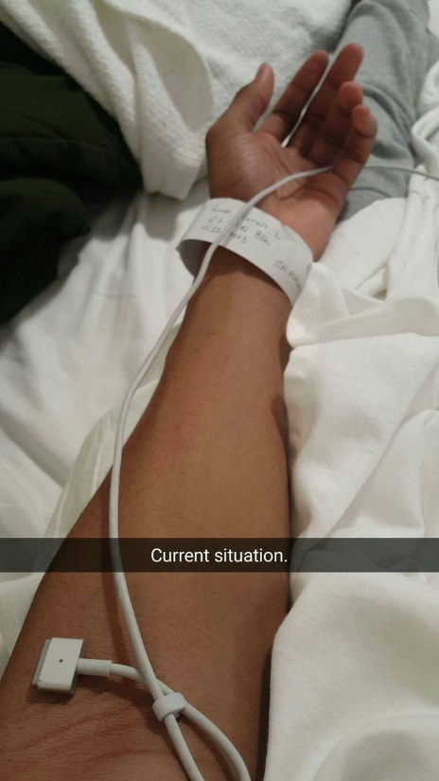
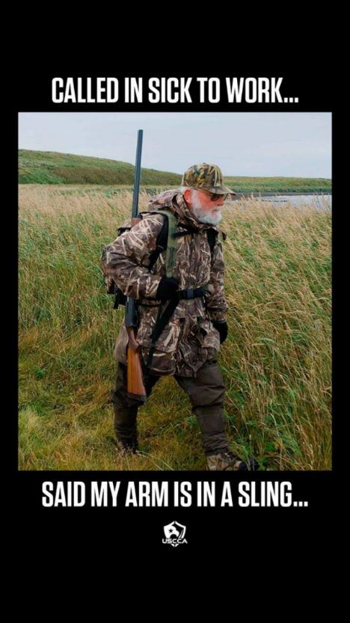
Perspective

Slide 10
Hard Skills versus Soft Skills
IQ (React) versus EQ (Respond)
IQ:
Number 2 lead pencil and fill some bubbles.
EQ:
The capacity to be aware of, control, and express one’s emotions, and to handle interpersonal relationships judiciously and empathetically.

Slide 11
Why are we here? Dodge Ergophobia
Carrots and sticks work….for episodic interactions
Loyalty does not matter….until one thing goes wrong
Relationships or features and prices?
Titles and Degrees or MBWA
Ruger or Sig? Starbucks or McDonalds
EQ could be your differentiated value proposition

Slide 12
10 Tips for working with a Millennial
Provide Structure
Provide Leadership
Promote positive self image
Promote Teamwork
Listen to them
They are up for a challenge and change
Multi Taskers
Electronic Literacy
Promote Life Work Balance
Make work fun

Slide 13
Progression of an Injury
If you know this….then…..
Hassle
↓
Discomfort → Pain
↓
Injury

Slide 14
Preventing Back and Other Ergonomic Related Injuries
Why not report injury to a supervisor?
MANDATORY
Put on a list
Do you report every ache and pain to a doc?
It will go away
Peer Pressure
Safety Goals
Management by threat – Report or else!
Surveys are better than nothing-but not great
Notes:
12
17

Slide 15
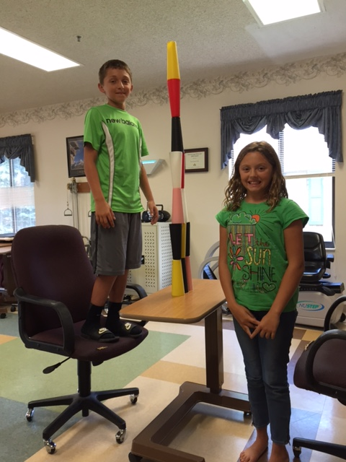
On-Site: Poor use of equipment, unsafe acts, increased risk, poor planning, culture

Slide 16



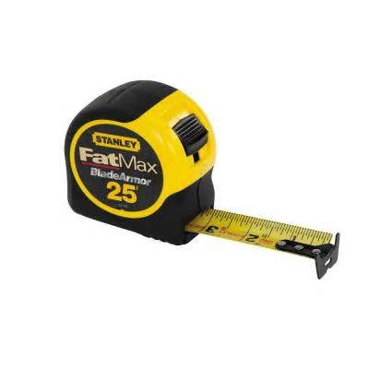

Preventing Back and Other Related Ergonomic Related Injuries
Notes:
12
17

Slide 17
Preventing Back and Other Ergonomic Related Injuries
Training Mistakes
• Question from HR:
Do you know the benefits of regular exercise?
• Answer from overweight unhealthy employees:
Yes because you told us last year and we have 10 posters
Notes:
12
17

Slide 18
Preventing Back and Other Ergonomic Related Injuries
Training Mistakes
Training didn’t work – bring ‘em back
Assuming common sense
“Teach” and “Train” how to lift
Equip. is the problem – 4 knobs, now 8
Teach people what they know – Thanks??
“Mandatory” = Optional with Consequences
Ignore Feelings - Trigger
Notes:
12
17

Slide 19
Preventing Back and Other “Ergo” Related Injuries
How does EQ / Morale fit into this?
Does it really have an impact on the risk of injury?
Dr. Marras The Ohio State University
Notes:
12
17

Slide 20
Results

Slide 21
Risk Factors – Morale
I want to go on a vacation
My boss is a jerk
I am tired of mandatory overtime
I have a true fear of re-injury
Dr. Marras – Poor Job

Slide 22

Enough is Enough
What the heck am I looking for?
I am wearing 10 hats
Bring me back to the old days of do what you are told

Slide 23
Does Emotional Intelligence and Customer Service really matter in the workplace?
Avita Health System WorkWell
Jared Cass, OTR/L, CEAS I,II, TWD
Director of Occupational Medicine & Employee Health
jcass@avitahs.org
419-566-3888
Notes:
12
17

