Slide 2
Managing claims & Understanding premium
Stacy Harrington
Regional Business Consultant
419-606-4617
Stacy.Harrington@bwc.ohio.gov

Slide 3



Agenda
BWC Claim Process
Premium Calculation
Claim Management Strategies
Office of Safety Services

Slide 4

Participants involved in a claim
  Injured worker*
  Employer*
  Bureau of Workers’ Compensation*
  Managed Care Organization
  Provider(s)
  Industrial Commission
  Third Party Administrator
  Attorneys
  * Parties to the claim

Slide 5
Compensable claims
  Employer/employee relationship
  Accidental in nature
  In the course of and arising out of employment
  Physical injury/occupational disease
  Ohio jurisdiction
  Offsite medical treatment

Slide 6
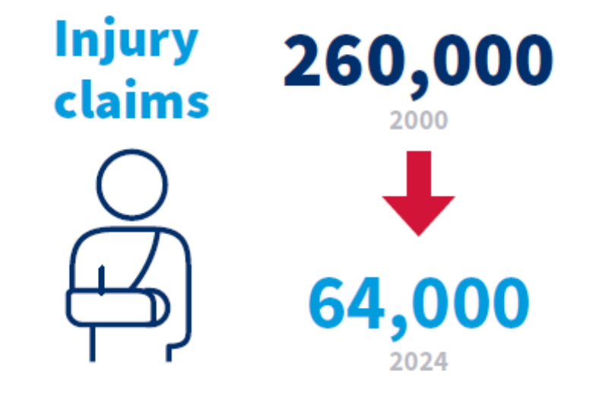
Fun fact

Slide 7
Medical benefits
Outpatient medical facilities
Durable medical equipment
Diagnostic tests
Prescriptions
Prosthetics
Office visits
Physician bills
Physical therapy
Surgery
Hospital charges

Slide 8
Indemnity benefits
  Temporary total
  % Permanent partial
  Wage loss
  Living maintenance
  Change of occupation
  Facial disfigurement
  Scheduled Loss
  Permanent total
  Lump Sum Settlement
  Death

Slide 9

Ratemaking
BWC must collect enough money in premium to pay out claim costs
Costs must be equitable divided among all employers
Factors that determine what an employer pays in premium:
  Manual Classification
  Payroll
  Claim History

Slide 10
Experience Period
Private Employer: July 1, 2026 to June 30, 2027
Claims costs and payroll from policy years 2020, 2021, 2022 and 2023
Claims costs and payroll from calendar years 2020, 2021 2022 and 2023
Snapshot Date
September 30, 2025
Public Employer: January 1, 2026 to December 31, 2026
Snapshot Date
March 31, 2025

Slide 11
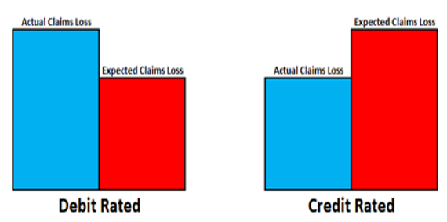
Experience Modifier
Compares actual claims costs to expected claims costs
Determines the percentage of the base rate an employer will pay

Slide 12
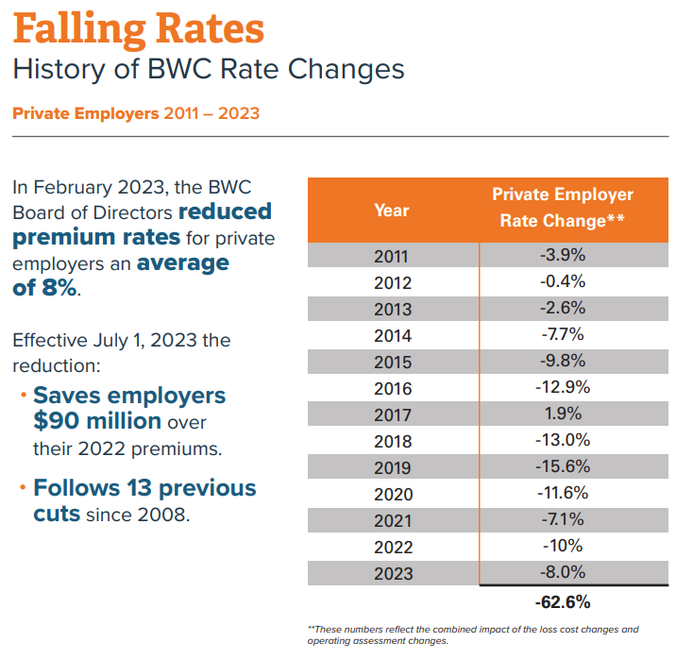
History of BWC Rate Changes: 2011-2026
Private Employers
In February of 2026, the BWC Board of Directors reduced premium rates for Private employers and average of 1%
YEAR | Private Employers | Public Employers
2011 | -3.9% | -5.3%
2012 | -0.4% | -4.9%
2013 | -2.6% | -5.1%
2014 | -7.7% | -1.0%
2015 | -9.8% | -8.1%
2016 | -12.9% | -12.6%
2017 | 1.9% | 0.3%
2018 | -13% | -6.0%
2019 | -15.6% | -11.6%
2020 | -11.6% | -5.9%
2021 | -7.1% | -7.9%
2022 | -10% | -9.9%
2023 | -8% | 0.6%
2024 | -7% | -3.9%
2025 | -6% | -0.0%
2026 | -1% | -1.0%
TOTAL | -70% | -57%
Public Employers
In August 2025, the BWC Board of directors reduced premium rates for public employers an average of 1%
Effective July 1, 2026, the reduction:
Saves Employers $10 million over their 2025 premiums.
Follows 16 previous cuts since 2008.
Effective January 1, 2026, the reduction:
Saves employers $1.8 million in premiums.
Since 2011, the overall impact of the rate change is -57%

Slide 13
Claims management strategies
Vocational Rehabilitation
Transitional Work Program
Salary Continuation
Disability Relief
Settlements
Subrogation
Non-at-Fault Motor Vehicle Accident
C-59 Recreational Waiver
$15K Medical Only Program
Fraud Reporting

Slide 14

Vocational Rehabilitation
Experiences a smoother transition back to regular duty
Keeps jobs skills current
Reduces problems related to inactivity
Work with a vocational rehabilitation case manager
Program costs are charged to the surplus fund

Slide 15
Transitional work
    Accommodate Restrictions
    Formal Policy
    Transition Work Grant$

Slide 16

Salary continuation
Continuation of wages by employer in place of Temporary Total
Prevents compensation costs accruing in a claim
Regular wages and benefits must continue
Employer and injured employee must agree

Slide 17
Disability Relief
Diabetes
26 allowed conditions
Existed prior to the injury
Prolongs healing process
Contributes to the injury
Award percentage charged to the surplus fund
Epilepsy
Arthritis
Cardiac Disease
Cerebral Palsy
Notes:
18

Slide 18

Settlement
Can settle medical or compensation, or both
Reserve drops to zero
Money for settlement is paid by BWC
Settlement amount is added to total cost of claim

Slide 19
subrogation
The right to recover benefits from a third party due to negligence:
  Motor vehicle accidents
    Not-At-Fault MVA Exemption
  Malfunctioning products/machinery
  Medical malpractice
  Animal bites
Total of recouped funds are applied to the total cost of the claim

Slide 20

Not-At-Fault Motor Vehicle Accidents
Claim resulted from a motor vehicle accident involving a third party
Third party issued a citation or evidence of third-party responsibility
Employer files a request for consideration
Claim costs charged to the surplus fund

Slide 21
Recreation Waiver
Voluntary participation in employer sponsored recreation or fitness activity
Utilize the C-159 form
Must be signed prior to engaging in the activity
Examples: fitness programs and company outings

Slide 22
$15,000 Medical-Only Program
Employer pays up to $15,000 in medical bills for medical-only claims
Bills must be paid within 30 days of receipt
Must keep record for 6 years
Employer responsible for Medicare reporting
Exceptions / Opt Out
Contact BWC within 14 days of claim being filed
Reached $15K limit
Notify BWC of last date of service you will pay

Slide 23
Fraud
ABUSE
versus
Requires “knowledge & intent”
Overt act
Intentional omission
Excessive use or misuse of workers’ compensation system
Abuse can not be criminally prosecuted under the law
Dealt with through administrative channels (IC)
FY2025: BWC identified $92 Million in fraud

Slide 24
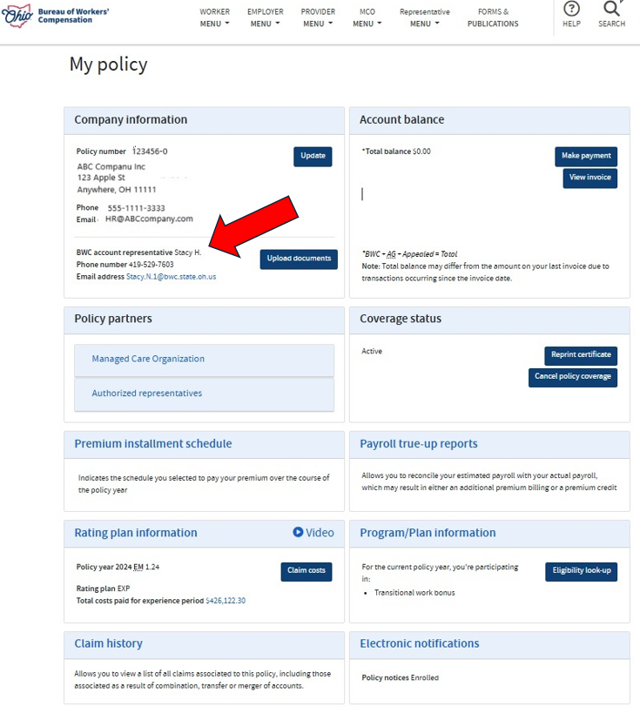
Assistance with BWC

Slide 25
Office of Safety Services
Safety, Hygiene and Ergonomic Consulting
Research library services
Video Streaming Library- Streamery
BWC Learning Center (www.bwclearningcenter.com)
In-person
Online: Virtual Training Courses & On-demand
Webinars

Slide 26
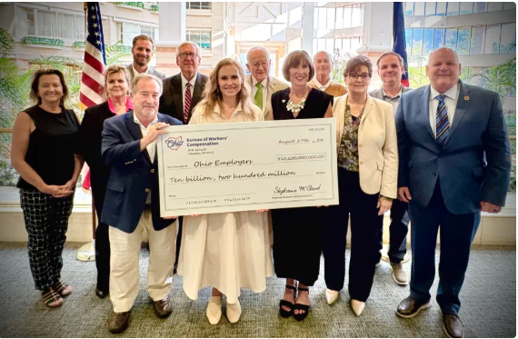
BWC Dividend

Slide 27
Questions?
BWC.OHIO.gov
Stacy Harrington
Regional Business Consultant
Northwest Ohio: Toledo, Lima & Mansfield
419-606-4617
Stacy.Harrington@bwc.ohio.gov

