Slide 1

Mat Safety
With Zach Morral

Slide 2
Overview
Provide you with accurate information regarding mat safety at your place of business.
Help to understand the importance of mat safety.
Realizing the risks that come without having mats
Show you what options are out there for your company.

Slide 3
Why are Commercial Mats
Important?
Customer and Employee Safety: One of the main benefits of installing commercial entrance floor mats is to ensure the safety of all human traffic using the building.
Cleanliness: Floorcare is an important part of managing an office if you want to maintain a clean and safe building. Commercial door mats actively trap dirt and moisture when people walk into a building. This reduces the spread of dirt and water throughout the premises, helping to keep floors safe and clean.
Maintain Excellent Floor Condition: If the entrance floor mats are not in place, you will have these harsh substances and debris scraping your floors from the soles of the shoes of all human traffic.
Identification: Logo mats are another way to incorporate your branding throughout your building, adding an extra level of professionalism to your entrances. These mats can also be customized with special messages, giving you some ability to get creative in addition to keeping your floors safe and clean.

Slide 4

Benefits of Mats
S.P.A.C.E.

Slide 5
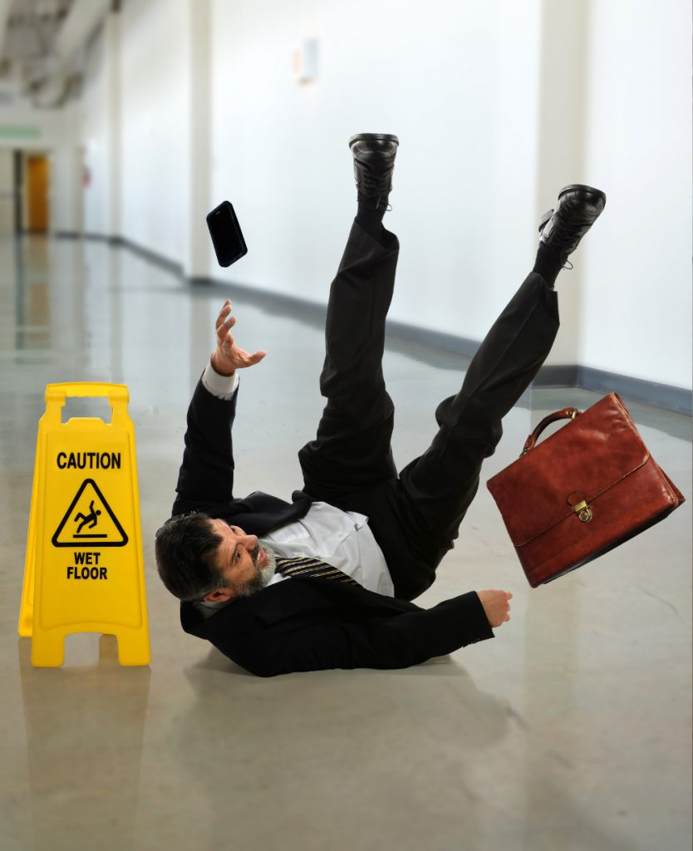
What Does S.P.A.C.E. Stand For?
S = Safety
P
A
C
E

Slide 6
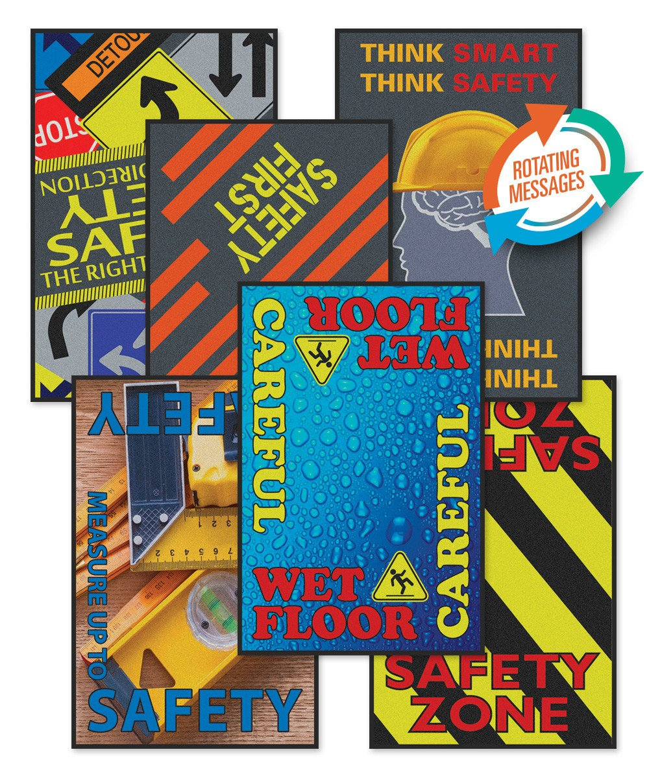
SAFETY
Mats can reduce the risk of potentially deadly or injurious slips, trips and falls
Matting can also provide drainage and dry work surfaces in wet work environments
Safety Message Mats can help present the message you would like to get across to your employees before they start their shift

Slide 7
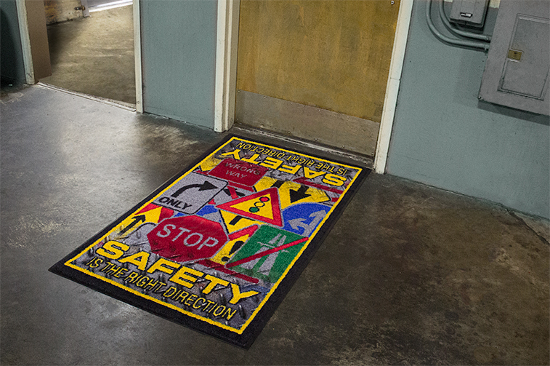
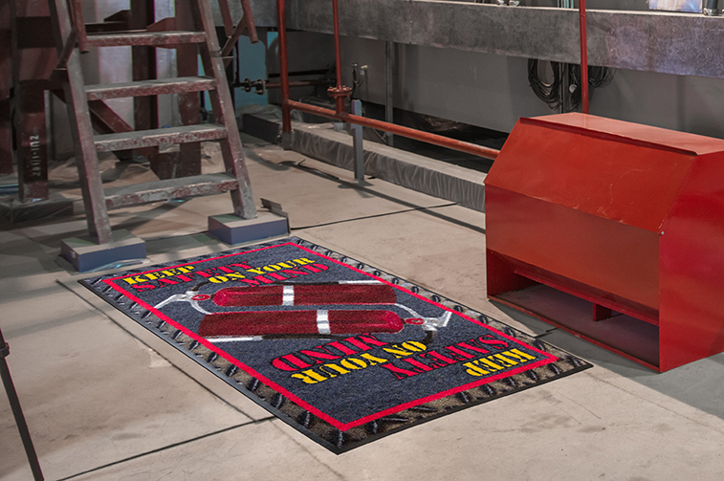
Safety Message Mat Areas
Time Clocks
Locker Rooms
Employee Entrance
Drinking Fountains
Bulletin Boards
Break/Lunch Rooms
Vending Machines

Slide 8

National Floor Safety Institute
Slip and Fall Injury Facts
Slip and fall accidents are the leading cause of worker’s compensation claims
A slip/fall cost per claim is well over $20,000, which is second only to auto accident claims.
Accidents from falls equate to over 8 million hospital emergency visits per year
Compensation & medical costs associated with employee slip/fall accidents is approximately $70 billion annually.
22% of slip/fall incidents resulted in more than 31 days away from work
85% of worker’s compensation claims are attributed to employees slipping on slick floors
Not to mention the legal expense!

Slide 9
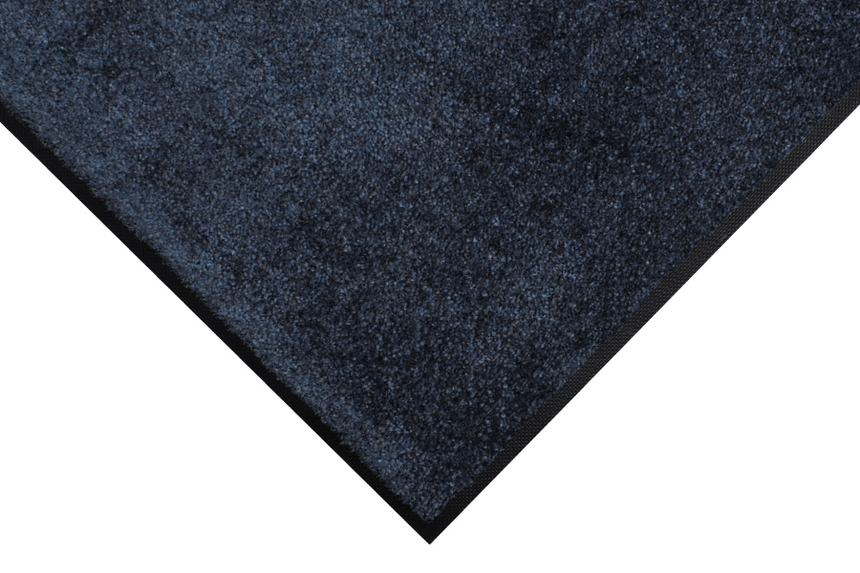
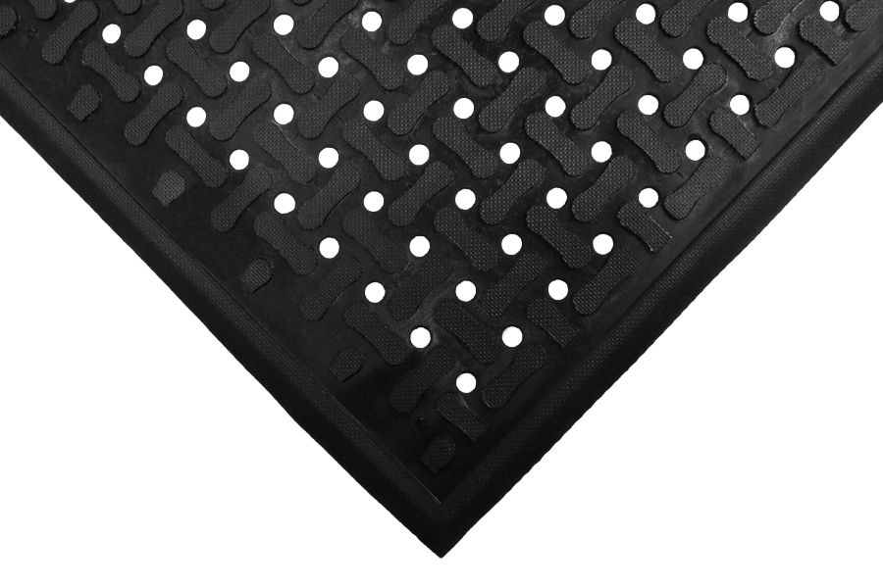

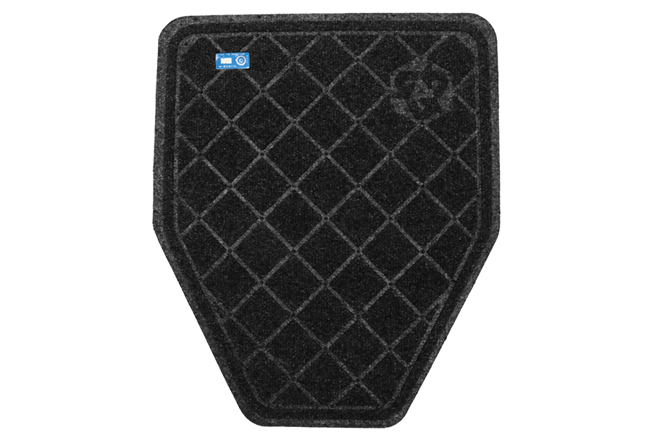

What Mats Are Out There?
Entrance Mats & Scrappers
Anti-Fatigue Mats
Safety Message Mats
Logo Mats
Restroom Urinal Mats

Slide 10

What Does S.P.A.C.E. Stand For?
S
P = Protection
A
C
E

Slide 11
Protection….Floors
Facts
70%–90% of dirt that enters a facility is tracked in on people’s shoes — that’s a quarter pound per day per 1,000 people!
Without entrance matting and all the tracked-in dirt, 1,500 people can remove 42% of the finish off a floor. This is why the tracked-in soil is the number one cause of building maintenance costs.
Reducing the dirt is critical to the bottom line.
Commercial floor mats reduce tracked-in dirt by 80% — that’s a savings of $500–$900 in maintenance costs for every pound of dirt stopped.
A strategically placed and professionally maintained floor care program can also help reduce these slip/fall costs.

Slide 12

What Does S.P.A.C.E. Stand For?
S
P
A = Appearance
C
E

Slide 13



Appearance
Logo mats are the perfect way to help expand your brand. They are ideal for your main entrance way. Logo proofs are no cost to your company. A one time fee of $75.00 for an art charge.
Logo proofs are generally returned to you in less than 4 hours
Mats are manufactured and shipped in 1-2 days
No backorders
All mats are certified by NFSI- National Floor Safety Institute

Slide 14

What Does S.P.A.C.E. Stand For?
S
P
A
C = Cost Savings
E

Slide 15
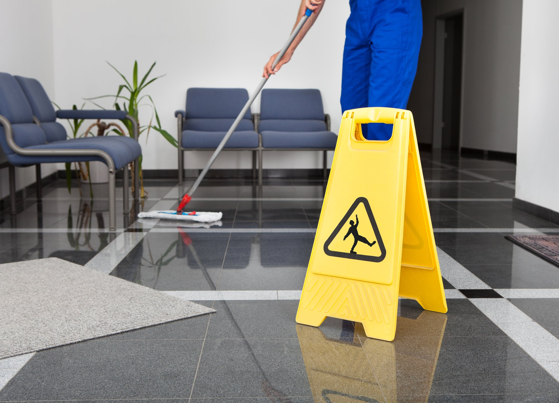
Cost Savings
It is estimated that 90% of building maintenance cost, is labor.
Think about the chemicals used to clean and finish flooring.
The estimated cost of removing a single pound of dirt from a modern building can exceed $600.
39% of all custodial time is devoted to floor care maintenance
Less frequent floor cleaning, striping and waxing
A dollar spent keeping soil out of a building will save $10 in removing soil once it’s inside

Slide 16
What Does S.P.A.C.E. Stand For?
S
P
A
C
E = Ergonomics

Slide 17
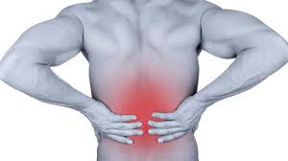
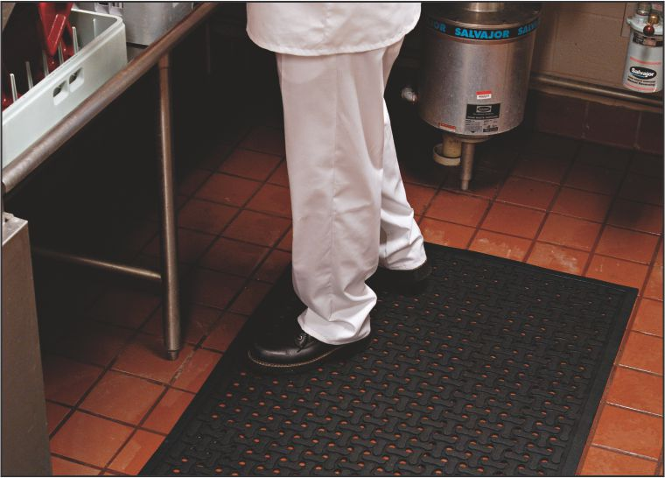
Ergonomics
Ergonomics: is the science that deals with designing and arranging items so that people can use them easily and safely.
Standing on hard surfaces for extended periods of time leads to fatigue and lost productivity.
Back pain is the number 2 reason for missed time at work
Productivity drops by 33% for a person standing 8 hours on a concrete floor
The National Safety Council recommends the use of Anti-Fatigue mats
Anti-Fatigue mats can reduce the effects of prolonged standing, reducing absenteeism and increasing productivity.

Slide 18
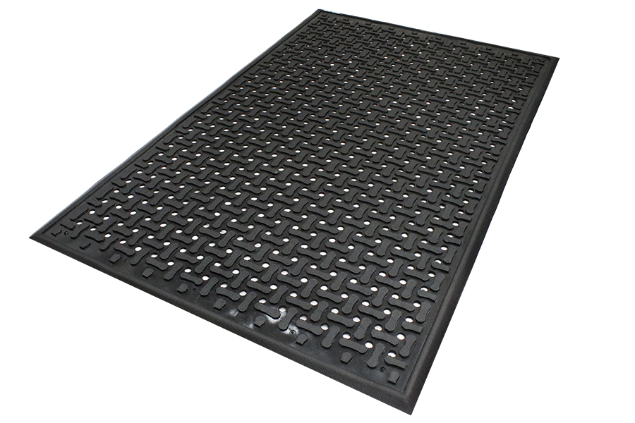
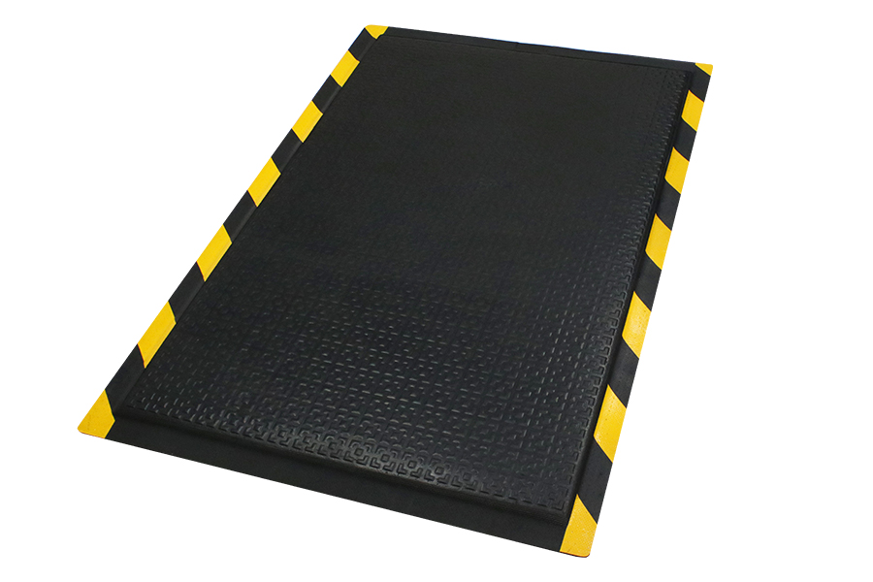
Anti-Fatigue Mats
Comfort Flow Mat
Comfort Flow is a flow-through mat with excellent anti-fatigue properties designed for wet areas where grease, oil, and chemicals may be present.
Happy Feet Mat
Heavy-duty anti-fatigue mat that features a dense foam cushion encapsulated in nitrile rubber, making it suitable for both wet and dry environments.

Slide 19
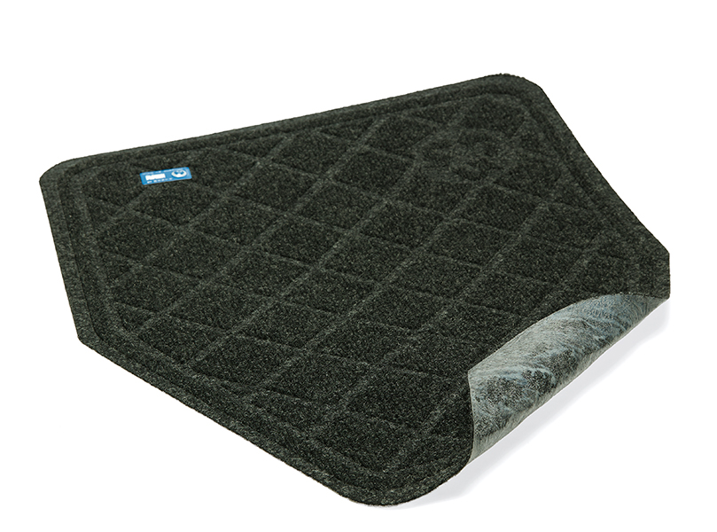
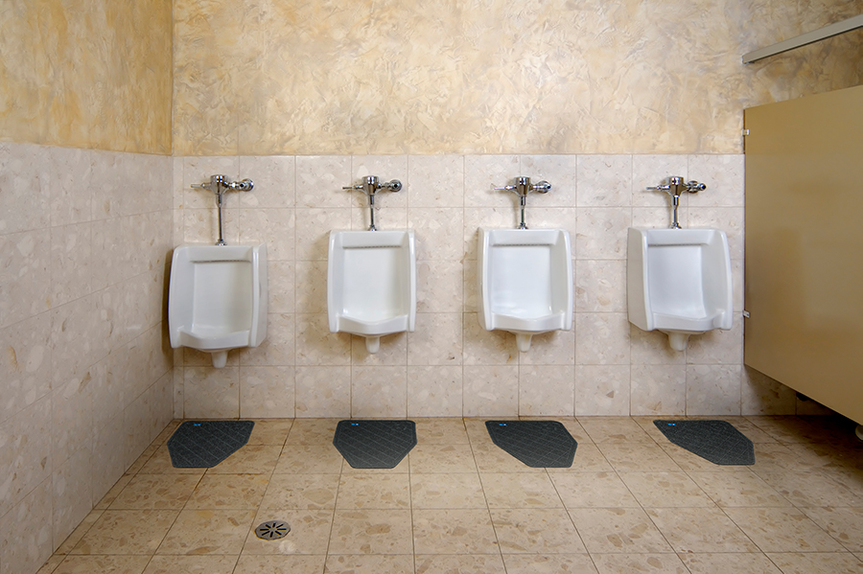
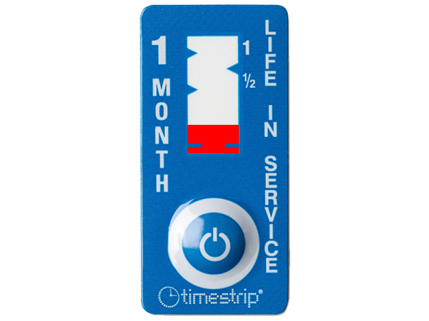
Restroom Mats
CleanShield Urinal Mat
Premium restroom mats designed to help prevent odors, as well as, protect floors and grout from uric acid damage.
Disposable anti-microbial urinal mats
Designed for 30-day usage; easy-to-read TimeStrip indicates when it's time to replace the mat (step on/push to initially activate)
Dries Quickly - Surface dissipates moisture quickly for fast drying time
Hassle Free - Mats can be left in place during daily floor cleaning; floor scrubbers, mops, and brooms will pass right over them without causing damage
Safe - Certified high-traction by the National Floor Safety Institute (NFSI)

Slide 20
Questions about the mats or Kimmels?
Entrance Mats
Anti-Fatigue Mats
Safety Message Mats
Logo Mats
Restroom Urinal Mats

Slide 21
Thank You for Your Time
Zach Morral
C: 419.889.4121
zach.morral@kimmelcleaners.com

