Slide 1
Marijuana & The Workplace
Jo McGuire
jo@jomcguire.org
www.jomcguire.org

Slide 2
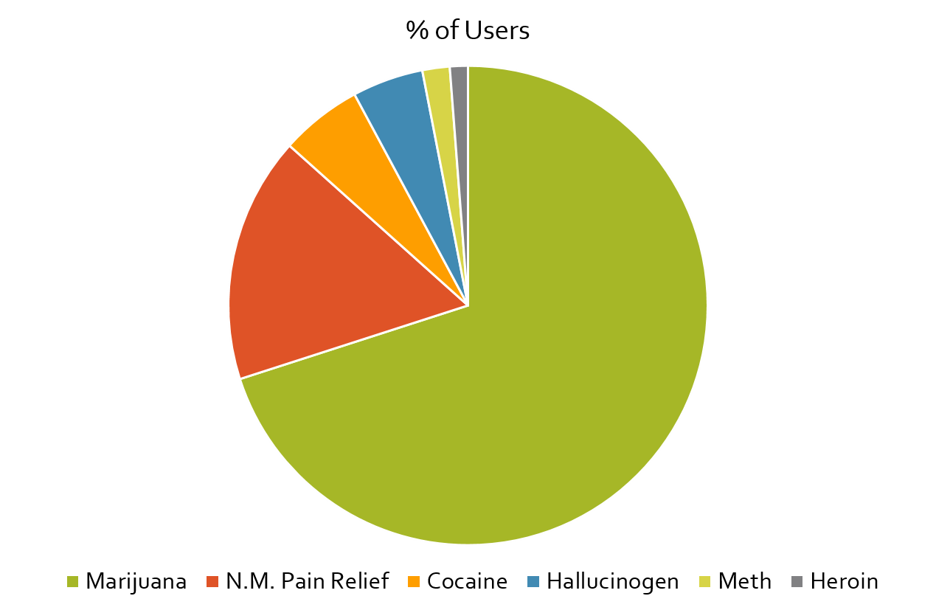
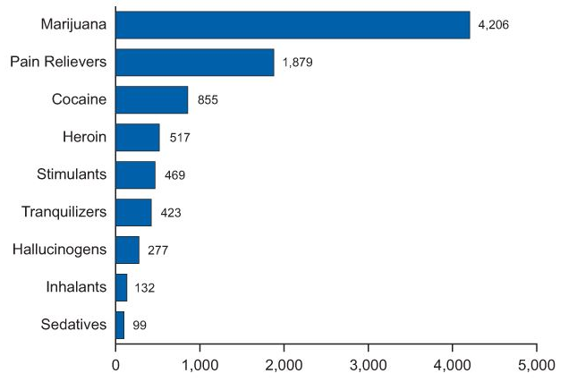
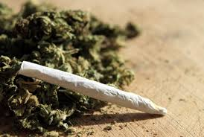
Marijuana is the most commonly used drug in the U.S.
*Numbers in thousands
National Survey on Drug Use & Health (NSDUH) 2015

Slide 3
over 75% of U.S. employees live in a state where marijuana is legal in some form
51%: Med Marijuana States = 63 Million
26%: Recreational MJ States = 33 Million
23%: Illegal States = 27 Million
https://www.bls.gov/ces/home.htm

Slide 4
employees and illicit drug use
9.1% of F/T employees are illicit drug users
13.7% of P/T employees are illicit drug users
http://www.samhsa.gov/data/sites/default/files/NSDUHresultsPDFWHTML2013/Web/NSDUHresults2013.pdf

Slide 5
workplace drug use
F/T workers age 18-49 who currently use
illicit drugs, report they have:
Worked for 3 or more employers in the past year
Voluntarily left an employer in the past year
Were fired by an employer in the past year
An Analysis of Worker Drug Use and Workplace Policies and Programs, SAMHSA

Slide 6
workplace drug use
F/T workers age 18-49 who currently use
illicit drugs, report they have:
Taken an unexcused absence in the past month
Requested early dismissal or time off
Had absences of 8 days or longer & significantly increased tardiness
An Analysis of Worker Drug Use and Workplace Policies and Programs, SAMHSA

Slide 7
workplace drug use
44% sold drugs to other employees
64% admitted that drugs adversely affected their job performance
18 % had stolen from co-workers to support their drug habit
http://www.dol.gov/elaws/asp/drugfree/benefits.htm

Slide 8
workplace drug use
3.6x more likely to be involved in a workplace accident
5x more likely to file a workers’ compensation claim
⁹Backer, T.E. Strategic Planning for Workplace Drug Abuse Programs, p. 4. NIDA. Rockville, MD.

Slide 9
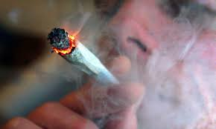
workplace marijuana use
55% more industrial accidents
85% more injuries
75% more absenteeism
Crites-Leoni, Abbie. "Medicinal Use of Marijuana: Is the Debate a Smoke Screen for Movement Toward Legalization?" Journal of Legal Medicine (1998): 273-280. Journal.

Slide 10
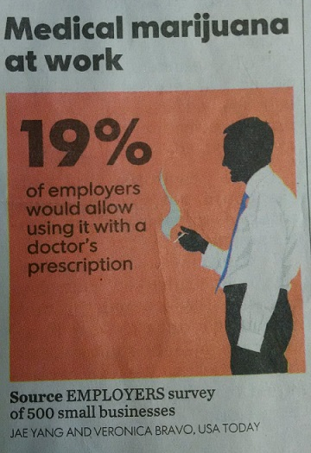
workplace marijuana use
According to the BC Coroner,
30% of forestry related deaths are attributed to cannabis
but none to alcohol
Elsevier Editorial System for Safety Science: Patterns of underlying causes of work-related traumatic fatalities – comparison between small and larger companies. Manuscript Number SAFETY-D-13-00224R1 2007

Slide 11
Did You Know?
Employee drug use costs U.S. businesses over $246 billion per year in lost revenue.
Small businesses can lose up to $7,000/month in lost productivity, employee turnover, absenteeism and tardiness.
www.nida.gov

Slide 12
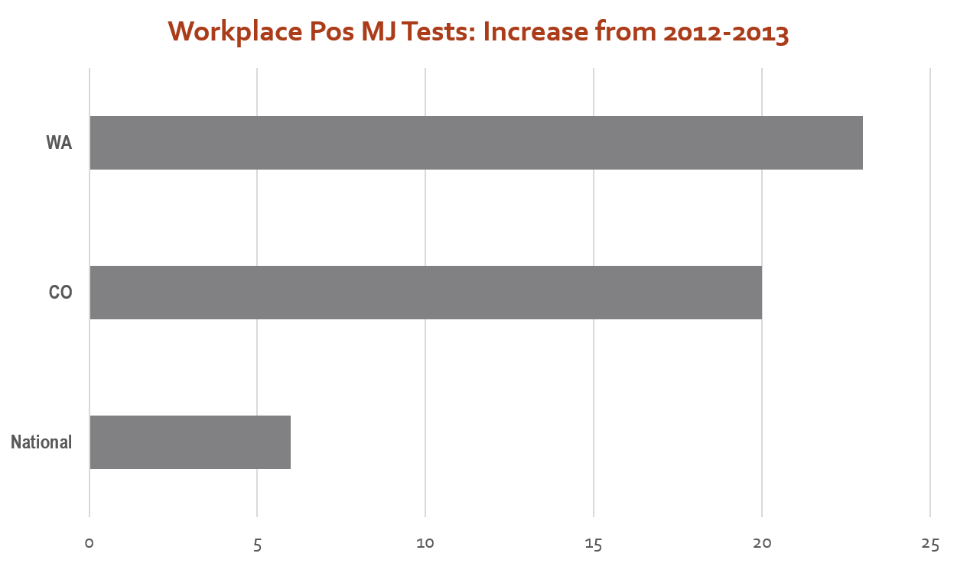

Slide 13
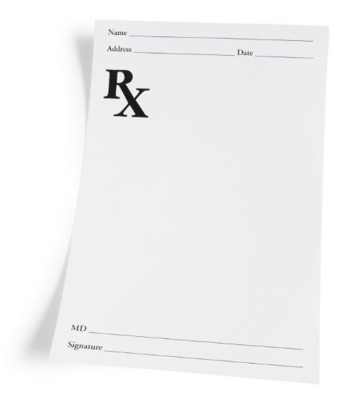
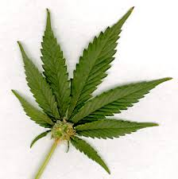
what does schedule I drug mean?
There is a high potential for abuse
Lack of any accepted medical use
No accepted safety standards for use under medical supervision
Unable to regulate dosing standards
USDOJ: DEA Denial of Application to Reschedule Marijuana August 12, 2016

Slide 14
contemporary marijuana
Highest THC potencies ever seen
New delivery systems that are beyond standard thinking
Longer lasting impairment
Confusing lack of standards regarding how to handle private use by employees
Edible products complicate the issue
Notes:
Why are we constantly talking about marijuana?
Because the properties and effects of marijuana are evolving so quickly that the professional world must work very hard to stay abreast of the facts, nuances and the scientific studies allowing us to learn more each day about what we are really dealing with. Let’s take these issues one step at a time:

Slide 15
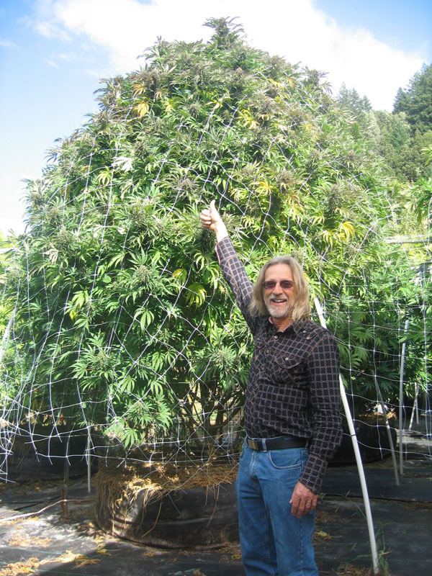
contemporary marijuana
Cannabis plants – Circa 1970’s
Today: 1 plant can produce 1 lb of pot per harvest

Slide 16
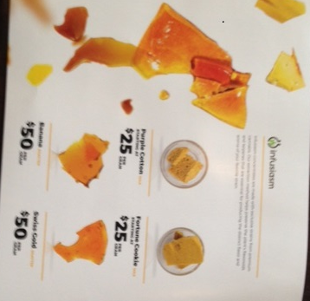
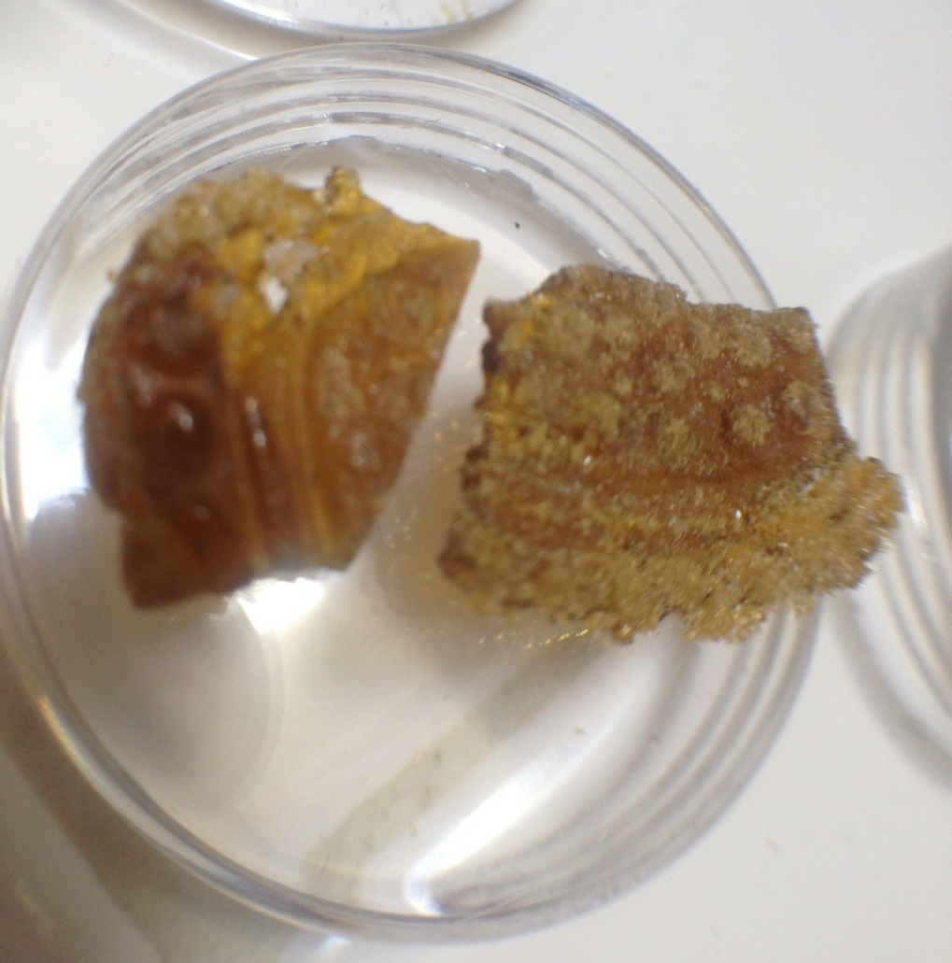
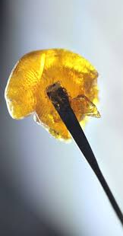
contemporary marijuana
“Just a plant” …. “It’s an herb” …. “It’s natural”
Notes:
Why are we constantly talking about marijuana?
Because the properties and effects of marijuana are evolving so quickly that the professional world must work very hard to stay abreast of the facts, nuances and the scientific studies allowing us to learn more each day about what we are really dealing with. Let’s take these issues one step at a time:

Slide 17
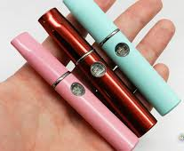
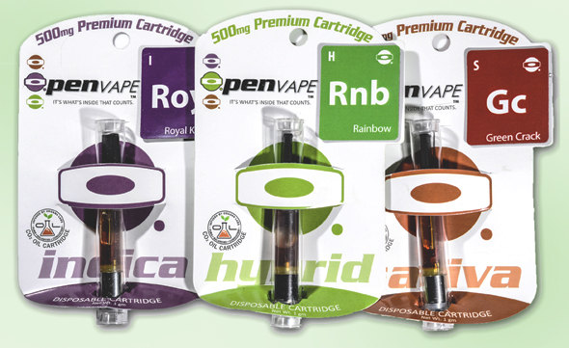
what’s trending
Notes:
The introduction of vaporizers to the marijuana market has allowed a revolution of new thinking in public consumption. The sophisticated products allow employees, students and people in the general public to consume concentrated hash oil virtually without notice. There is little to no obvious odor depending upon the sophistication of the product. Some companies are considering policies that are consistent with non-smoking on company property, however it is the impairment that must be considered thoughtfully when determining how to handle these products and their usage by employees.

Slide 18
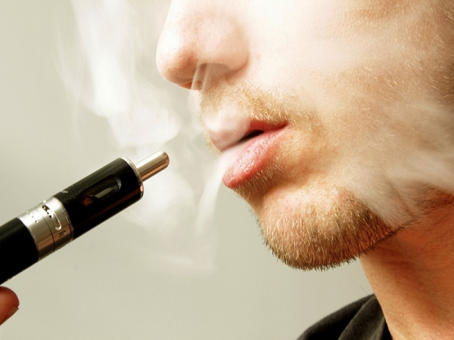
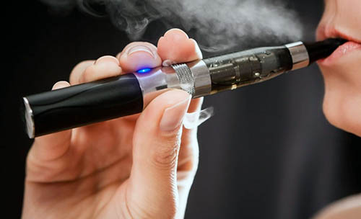
Vaping: Nicotine or Marijuana?
Can you tell which is which?

Slide 19
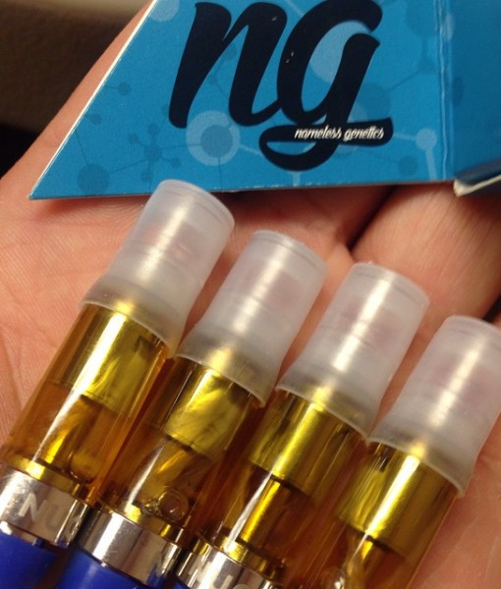
Vaping: Nicotine or Marijuana?
How about now?

Slide 20
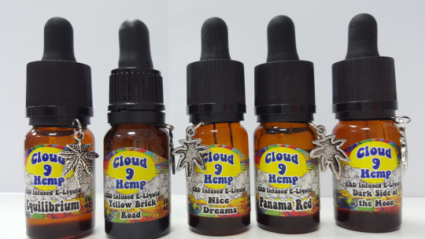
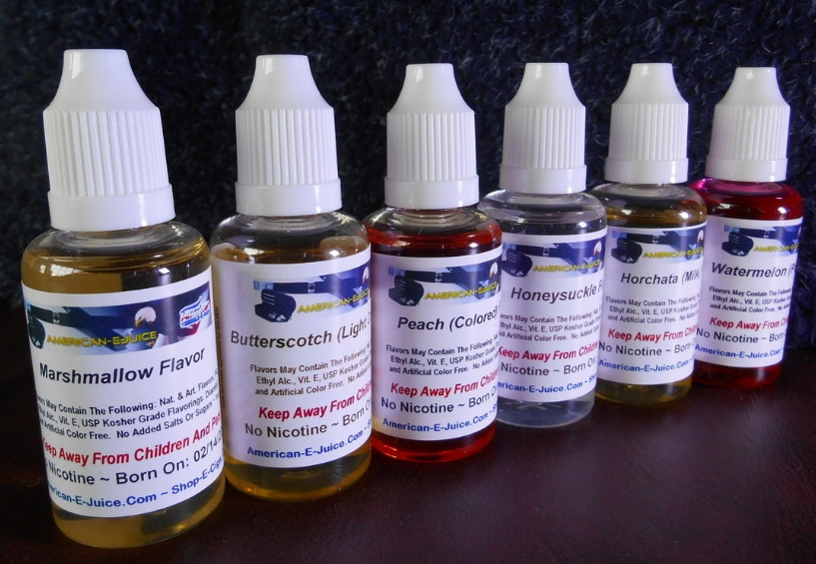
Vaping: Nicotine or Marijuana?
How about now?

Slide 21
Marijuana
Nicotine

Slide 22
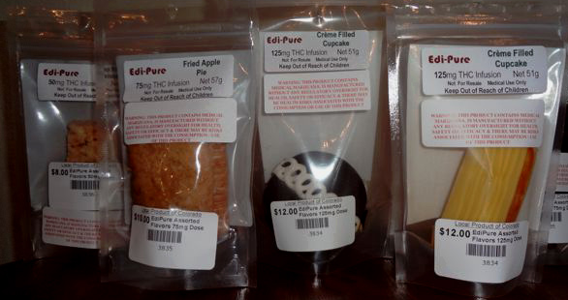
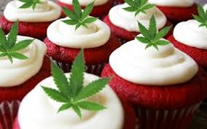
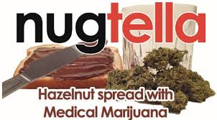
Notes:
Edibles come in an unlimited array of options that mirror foods you would see people eat every day without question.
Serving suggestions are not standardized, nor are there parameters for determining warning labels, etc.
Potency is highly variable.
Employers would have no way of knowing if an employer were to consume edibles during work hours, except for signs and symptoms of impairment which can take a little longer to manifest through the digestion system.

Slide 23
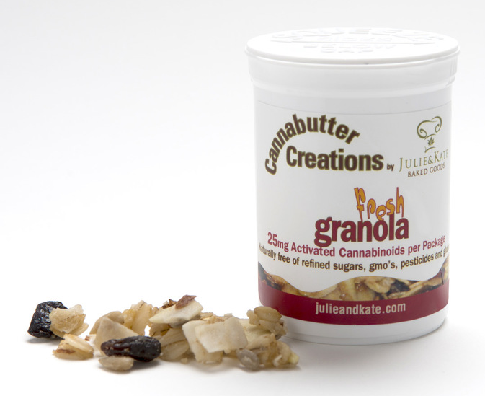
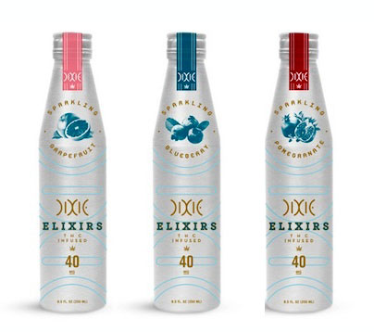
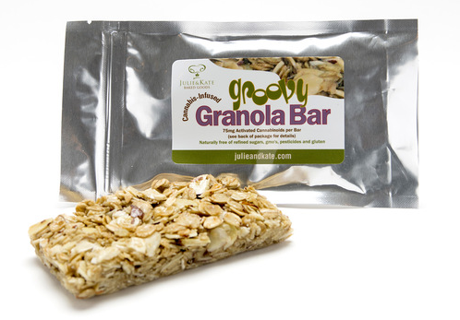
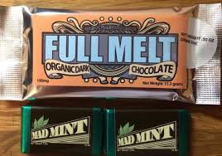
employer challenges
Notes:
Edibles come in an unlimited array of options that mirror foods you would see people eat every day without question.
Serving suggestions are not standardized, nor are there parameters for determining warning labels, etc.
Potency is highly variable.
Employers would have no way of knowing if an employer were to consume edibles during work hours, except for signs and symptoms of impairment which can take a little longer to manifest through the digestion system.

Slide 24
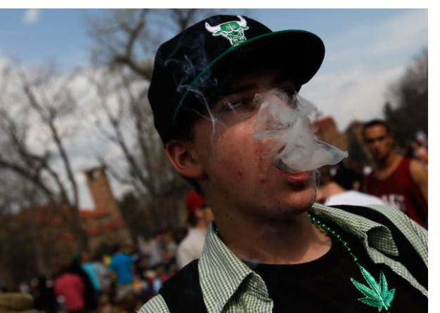
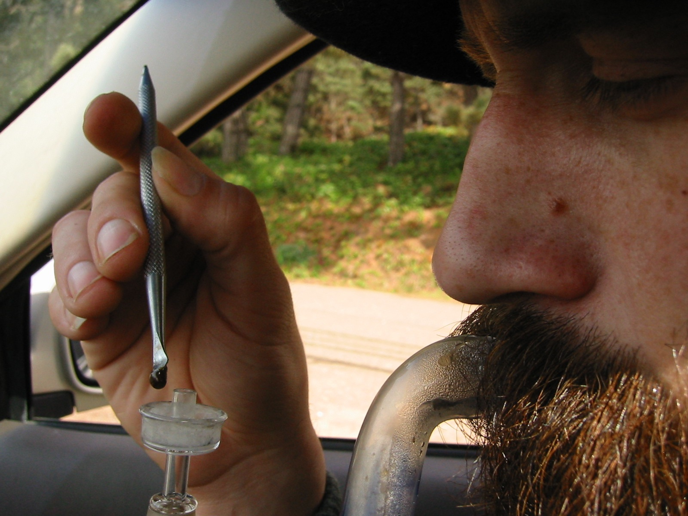
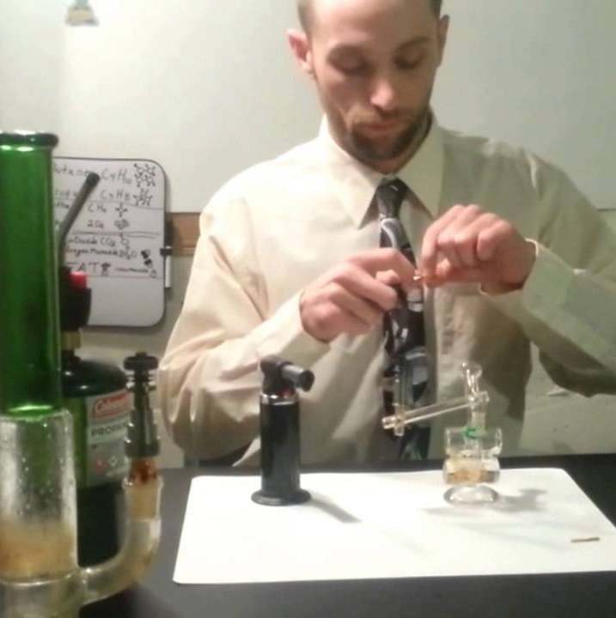
is “friday night use”
a big deal?!?!

Slide 26
24 hours after smoking one joint
Difficulty in aligning with and landing on runway
Increased vertical & lateral deviation from required flight path
Lateral deviation on approach to land twice pre-marijuana test
Sig increase in distance from center of runway on touchdown
One pilot landed off the runway entirely
Pilots not aware of any impairment
Yesavage JA, Leirer VO, Denari M, Hollister LE. Carry-over effects of marihuana intoxication on aircraft pilot performance: a preliminary report. Am J Psychiatry 1985; 142:1325-9.

Slide 27
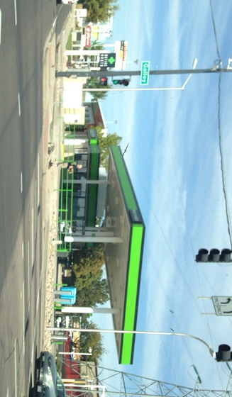
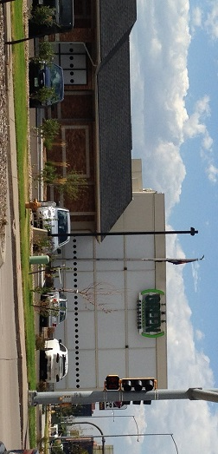
employer challenges
Noon on Thursday:
6 company trucks
8 company logos on shirts
Colorado Springs
Gas & Grass Station
Notes:
Edibles come in an unlimited array of options that mirror foods you would see people eat every day without question.
Serving suggestions are not standardized, nor are there parameters for determining warning labels, etc.
Potency is highly variable.
Employers would have no way of knowing if an employer were to consume edibles during work hours, except for signs and symptoms of impairment which can take a little longer to manifest through the digestion system.

Slide 28
job applicants at CO electric company
February 2015
12 applicants in the pre-employment process
Mobile drug test collector arrives
9 applicants walk-out
3 complete pre-employment drug screen
2 pass the drug screen
1 fails (THC positive)
vs

Slide 29
looking outside the state for qualified employees
“
Jim Johnson said his company has encountered so many job candidates who have failed pre-employment drug tests because of their THC use … it is actively recruiting construction workers from other states.
”
GE Johnson
http://gazette.com/drug-use-a-problem-for-employers/article/1548427

Slide 30
southern colorado challenges
Canon City Workforce Center
It took 2 months to find 3 CDL drivers that could pass the drug test. Salaries offered were competitive
Pate Construction
For every 75 people we interview, we can find about 15 who can pass the drug test

Slide 31
employer challenges
Exposure to Chemicals, Molds, Pesticides, Herbicides, etc.
Notes:
Edibles come in an unlimited array of options that mirror foods you would see people eat every day without question.
Serving suggestions are not standardized, nor are there parameters for determining warning labels, etc.
Potency is highly variable.
Employers would have no way of knowing if an employer were to consume edibles during work hours, except for signs and symptoms of impairment which can take a little longer to manifest through the digestion system.

Slide 32
employer challenges
Exposure to Chemicals
Notes:
Edibles come in an unlimited array of options that mirror foods you would see people eat every day without question.
Serving suggestions are not standardized, nor are there parameters for determining warning labels, etc.
Potency is highly variable.
Employers would have no way of knowing if an employer were to consume edibles during work hours, except for signs and symptoms of impairment which can take a little longer to manifest through the digestion system.

Slide 33
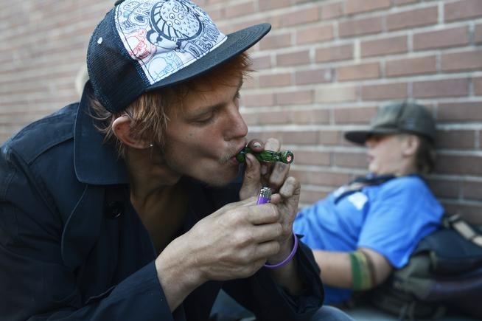
can’t pass a PE drug screen
Legal pot blamed for some influx of homeless in Denver 2014
Haven of Hope: 500% rise over normal in homeless in summer 2014 (50 to 300)
Salvation Army: 33% rise since 2014 compared to 2013
Salvation Army: Survey 25% increase related to marijuana
www.denverpost.com/news/ci_26216037/legal-pot-blamed-some-influx-homeless-this-summer

Slide 34
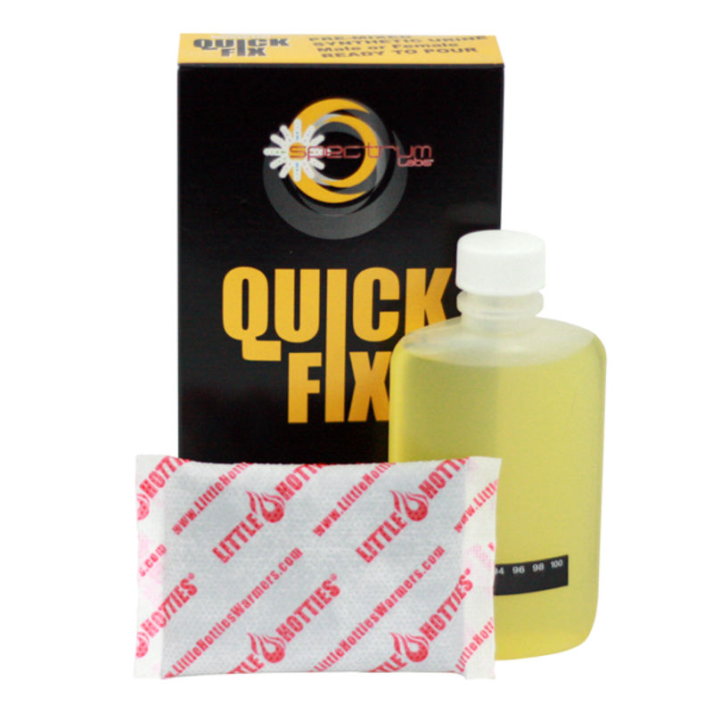
“In February,” Leona Willener said, “more than half the applicants who came to her company looking for work failed the required drug tests because of THC use … 1 in 3 attempted to cheat the test.”
“
”
Colorado Staffing Agency
http://gazette.com/drug-use-a-problem-for-employers/article/1548427

Slide 35
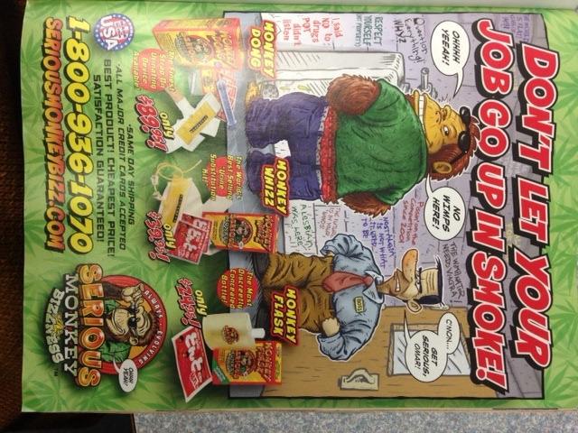
Do you know how to protect your business against the industry of Drug Test Cheating?

Slide 36
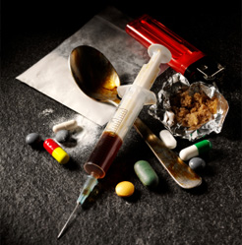
where is drug-friendly culture getting us?
The Quest Diagnostics Drug Testing Index shows the greatest increase in use of all illicit drugs by U.S. employees in 12 years, based on laboratory drug test results.
According to the U.S. Bureau of Labor Statistics drug and alcohol-related deaths in the workplace soared in 2016 with a spike of more than 30% in a single year.
The BLS also shows that fatal work injuries in 2016 were the highest since 2008.
https://www.questdiagnostics.com/home/physicians/health-trends/drug-testing
https://www.bls.gov/news.release/pdf/cfoi.pdf

Slide 37
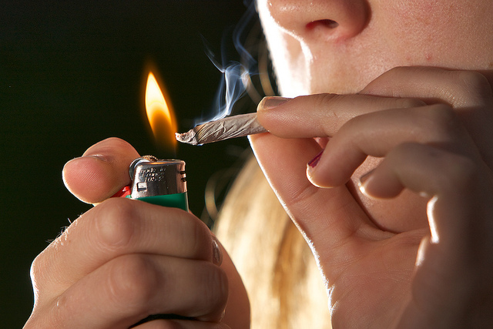
under the influence
Short Term for Standard THC Doses:
Red eyes, strong smell; problems with memory & learning
Distorted perception, difficultly in thinking & problem-solving
Loss of physical & mental coordination in divided attention tasks
Difficulty shifting attention to meet the demands of changes in the environment, and in registering, processing and using information
Perceptual functions are significantly affected
Diminished ability to concentrate and maintain attention
Distorted time & distance tracking
Residual effects have been reported from days to weeks
http://www.nhtsa.gov/people/injury/research/job185drugs/cannabis.htm
Notes:
Red eyes, strong smell; problems with memory & learning
Distorted perception, difficultly in thinking & problem-solving
Loss of physical & mental coordination in divided attention tasks
Difficulty shifting attention to meet the demands of changes in the environment, and in registering, processing and using information
Perceptual functions are significantly affected
Diminished ability to concentrate and maintain attention
Distorted time & distance tracking
Residual effects have been reported up to 24 hours
Another Source: http://www.webmd.com/mental-health/addiction/marijuana-use-and-its-effects

Slide 38
under the influence
Long Term for Standard THC Doses:
Fatigue, paranoia, possible psychosis, memory problems
Mood alterations, decreased motor coordination, lethargy, slurred speech, & dizziness
Impaired health – lung damage, behavioral changes, reproductive, cardiovascular & immunological effects
Respiratory problems similar to tobacco smokers , daily cough & phlegm, symptoms of chronic bronchitis. (The amount of tar inhaled and the level of carbon monoxide absorbed by marijuana smokers is 3 to 5 times greater than among tobacco smokers.)
http://www.nhtsa.gov/people/injury/research/job185drugs/cannabis.htm
Notes:
Fatigue, paranoia, possible psychosis, memory problems
Mood alterations, decreased motor coordination, lethargy, slurred speech, & dizziness
Impaired health – lung damage, behavioral changes, reproductive, cardiovascular & immunological effects
Respiratory problems similar to tobacco smokers , daily cough & phlegm, symptoms of chronic bronchitis. (The amount of tar inhaled and the level of carbon monoxide absorbed by marijuana smokers is 3 to 5 times greater than among tobacco smokers.)

Slide 39
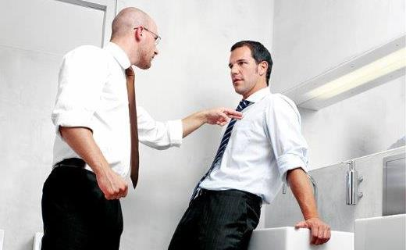
under the influence
Short Term for Extreme THC Doses:
Extreme paranoia
Hallucinations
Delusionary behavior that can turn violent
Bursts of violence, rage
Heart palpitations, increased risk of heart attack
Anxiety, panic attacks
ER Visits – currently higher than any other substance
The “high” has been reported to last for days, as yet unknown how long impairment can last
Notes:
The Drug Abuse Warning Network which shows emergency department admissions increasing from 16, 251 in 1991 to over 461,028 in 2012 (SAMHSA)
Deaths related to MJ in Colorado: Talk about student who plunged to his death while experiencing the effect of a marijuana edible. There was no other substance in his system in a 250 panel toxicology report.
The case where a man shot his wife to death after eating marijuana candy – in a paranoid delusion – he felt he needed to protect himself from outside attackers.
USA TODAY - http://www.usatoday.com/story/news/nation/2014/05/08/marijuana-pot-edibles-thc-legalized-recreational/8463787/
WSJ - http://online.wsj.com/articles/colorado-grapples-with-risks-from-edible-marijuana-1399675707

Slide 40
impaired driving
http://www.drugabuse.gov/news-events/news-releases/2014/05/more-colorado-drivers-in-fatal-car-crashes-testing-positive-marijuana
http://www.nbcnews.com/health/health-news/pot-fuels-surge-drugged-driving-deaths-n22991
Notes:
A new NIAAA- and NIDA-funded study shows an increased number of marijuana-positive Colorado drivers involved in fatal motor vehicle crashes since Colorado’s legalization of medical marijuana in 2009. A similar increase was not seen in the 34 states that did not have medical marijuana laws when this study was conducted. During the same time period, there was no change in the number of alcohol-impaired drivers in fatal motor vehicle crashes in either Colorado or the 34 then non-medical marijuana states.

Slide 41
what is the discussion REALLY about?
The right to Drug-Free vs. the right to Drug-Use
Safety vs. Liability
Responsibility vs. Culpability
Productivity vs. Loss/Risk Control

Slide 42
boundaries work
Swerdfeger Construction in Pueblo, Colorado has a robust company located in the heart of legal recreational marijuana territory and insists that maintaining a strong workplace drug and alcohol testing program has kept employees from engaging in activities that would put their safety record at risk.

Slide 43
boundaries work
Reg Rudolph who has been in the public utilities industry for 26 years in Pueblo, Colorado states, “We’ve had to make some major operational changes. Overall, from an HR perspective we’ve maintained a hard line on marijuana. So far, we’ve had no issues but we’ve been clear about our policy and interpretation.”

Slide 44
drug test programs have proven success
NSDUH: Workers who are not in a drug testing program have substance use rates 50% higher than those who are subject to mandatory drug testing.
The U.S. Department of Transportation’s model of drug-free workplace programs have achieved significant improvements in safety and productivity.
National Bureau of Economic Research: “Using the U.S. Military’s policy of random drug testing and zero tolerance, we find that a strict employer anti-drug program is a highly effective means of deterring illicit drug use among current users as well as potential users.

Slide 45
substances to be tested
Marijuana Federally Illegal Medical Review Officers will not verify a drug test as negative based upon information that a physician recommended that the employee use “medical marijuana.”
Marijuana remains a drug listed in Schedule I of the Controlled Substances Act.
It remains unacceptable for any safety‐sensitive employee subject to drug testing under the Company’s drug testing regulations to use marijuana.

Slide 46
marijuana & drug testing
Since marijuana is stored in the body’s fat cells, it can be detected for up to 30 days for CHRONIC use – NOT ONE TIME USE
5 ng/mL for roadside is strictly a whole blood test
Passes through blood quickly, must be captured within the hour
Blood vs. urine measurements are not comparable
Marijuana does not pass through the breath (potential for capturing oral fluid)
Stronger potencies are yielding higher THC results
Test results do not tell us precisely what, how often or how much is used

Slide 47
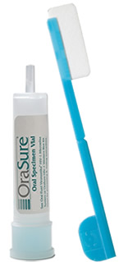
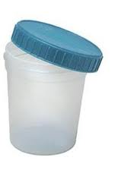
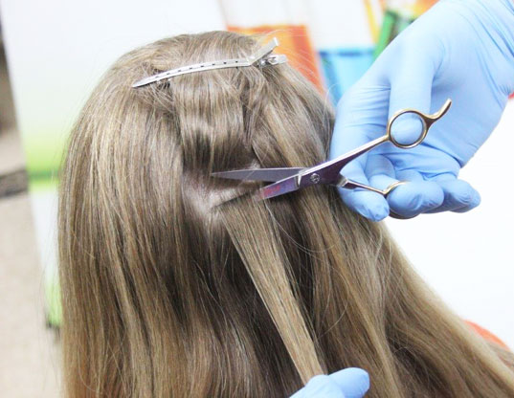

Slide 48
oral fluid testing
Less invasive
Always observed
Reduce opportunities to cheat the test
Can detect use within the last 15-24 hours
Lab-based results with MRO verification are evidential
Growing in popularity due to effectiveness
Excellent for roadside testing
http://www.orasure.com/docs/pdfs/products/intercept/Intercept-Detection-of-Marijuana-Use-by-Oral-Fluid-and-Urine-Analysis.pdf
Photo: quest diagnostics drug testing

Slide 49
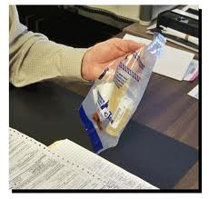
lab based urinalysis
Reliable, evidentiary
Gold standard of drug testing
Efforts must be taken to prevent cheating
Direct observation can prevent cheating
Detects occasional pot use 24-72 hours after use
DOT has added expanded opiates testing as of Jan 1

Slide 50
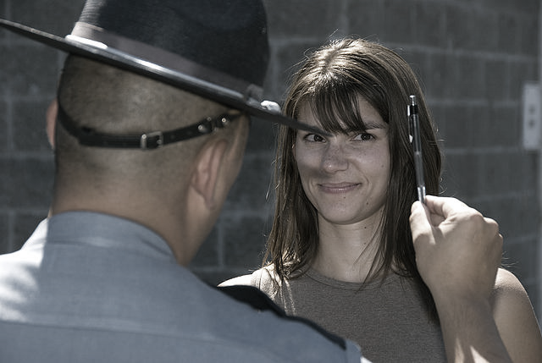
impairment testing
When Will We Have a Drug Test that Measures Impairment?
The short answer is: Not any time soon
It’s extremely complicated
States or Feds could “force” an impairment standard but it must hold up in court
Currently 5 ng in whole blood is highly contestable and losing more than winning
Presence-in-system simply is what it is

Slide 51
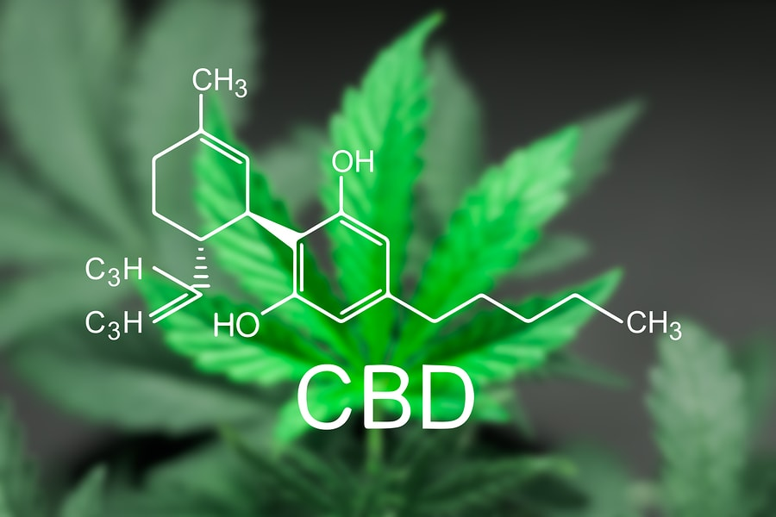
what about cbd?
Raw CBD (still raw cannabis) is a Schedule 1 drug
The ratio of THC and CBD used in pharmaceutical trials is 1:1
Some OTC products contain CBD from hemp
Many products claiming to contain CBD are fraudulent, containing no CBD
Over 600 samples tested in Colorado
Most were THC-rich with no CBD
Those containing CBD had on average 0.1%
Alice P. Mead; Finding the Medicine in Marijuana; Oct 1, 2015; GW Pharmaceuticals
http://www.nbcnews.com/storyline/legal-pot/legal-weed-surprisingly-strong-dirty-tests-find-n327811

Slide 52
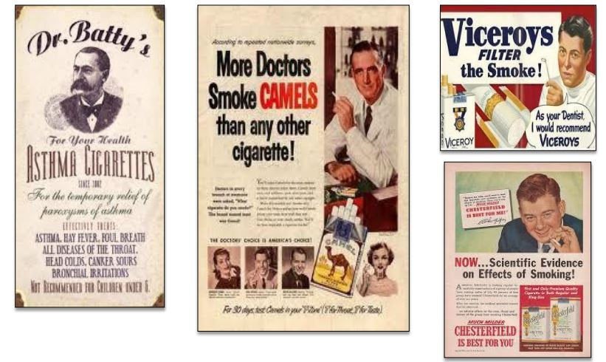

Slide 53
cbd & drug testing
Will CBD show up in a drug test?
Most “CBD” products contain high amounts of THC. If the product contains THC (which is likely) it will produce a positive drug test result.
Photo: Blitzed Vapor CBD Infused Coffee

Slide 54
workplace policies
What about removing THC from the drug screen?
What about increasing the THC limit?
How much is enough? How much is too much?
What about allowing recreational use for other drugs used as medications?
What about medical use of any illicit drug or alcohol?

Slide 55
workplace policies
There are solutions for keeping people working
Re-apply in 30 days
Suspensions for positive drug tests
Random programs
Substance Abuse Counseling & Recovery

Slide 56
position descriptions
Define who is safety sensitive and who is not
Articulate why each position description should/may not operate under-the-influence of drugs/alcohol

Slide 57
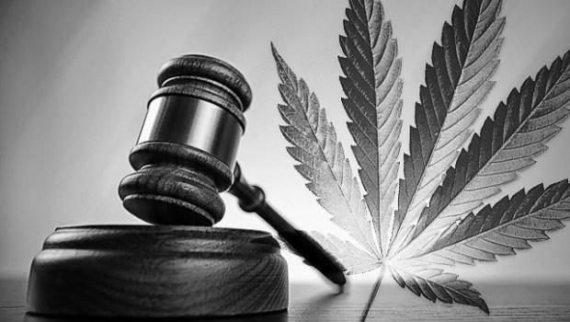
employer’s rights
“Nothing in this section is intended to require an employer to permit or accommodate the use, consumption, possession, transfer, display, transportation, sale or growing of marijuana in the workplace or to affect the ability of employers to have policies restricting the use of marijuana by employees.”
Notes:
Amendment 64 is very clear in that employers must not be forced to tolerate or accommodate the effects of marijuana in the workplace. This is duplicated in Colorado State Law in several areas concerning workplace safety.
Every HR person should ask themselves – which position in our company can afford impaired workers? The answer to that should be “none”.

Slide 58
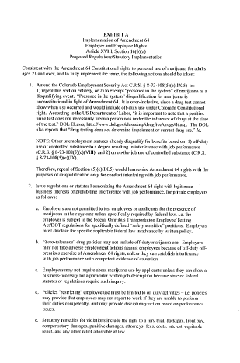
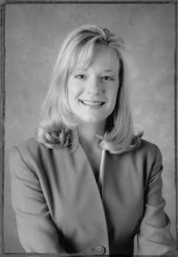
“Every existing Colorado law that is not compliant with Amendment 64 should be changed …. because an employee’s Constitutional Right to use marijuana supersedes an employer’s right to drug test.”
– Kimberlie Ryan, Atty
Notes:
Amendment 64 is very clear in that employers must not be forced to tolerate or accommodate the effects of marijuana in the workplace. This is duplicated in Colorado State Law in several areas concerning workplace safety.
Every HR person should ask themselves – which position in our company can afford impaired workers? The answer to that should be “none”.

Slide 59
employer’s rights
Safe & Drug Free Workplace Act
Protecting employees, customers, the work-environment and the public:
Every employee has a FAMILY
Notes:
Colorado law repeatedly states that substances “present in the system” qualify for positive drug tests. While marijuana proponents decry this as unfair because it may not necessarily mean “impairment” at the time of the test – remember 3 important issues:
Presence in system testing is the only scientific method currently available. Also – every other drug test result is ALSO presence-in-system testing.
Aside from pre-employment testing – you are also using signs and symptoms of impairment and/or drug use violating safe and drug free workplaces to make your determination
In Colorado – the unsafe behaviors of an employee alone are enough to take action. While confirmatory testing is helpful – you are not bound to a decision solely based on a drug test result. Make sure your policy is very clear that erratic/unsafe behaviors are actionable.
Colorado Unemployment Law:
http://www.colorado.gov/cs/Satellite?blobcol=urldata&blobheader=application%2Fpdf&blobkey=id&blobtable=MungoBlobs&blobwhere=1251874262653&ssbinary=true
Colorado Worker’s Compensation Act:
http://www.colorado.gov/cs/Satellite?blobcol=urldata&blobheader=application%2Fpdf&blobkey=id&blobtable=MungoBlobs&blobwhere=1251874262653&ssbinary=true
Medical Marijuana Act: http://www.colorado.gov/cs/Colorado+Constitution+Article+XVIII.pdf

Slide 60
employer’s rights
Know Your State Laws
Employer’s Rights
Unemployment Laws
Worker’s Compensation Act
Provisions in States Where Marijuana is Legal in Some Form
Notes:
Colorado law repeatedly states that substances “present in the system” qualify for positive drug tests. While marijuana proponents decry this as unfair because it may not necessarily mean “impairment” at the time of the test – remember 3 important issues:
Presence in system testing is the only scientific method currently available. Also – every other drug test result is ALSO presence-in-system testing.
Aside from pre-employment testing – you are also using signs and symptoms of impairment and/or drug use violating safe and drug free workplaces to make your determination
In Colorado – the unsafe behaviors of an employee alone are enough to take action. While confirmatory testing is helpful – you are not bound to a decision solely based on a drug test result. Make sure your policy is very clear that erratic/unsafe behaviors are actionable.
Colorado Unemployment Law:
http://www.colorado.gov/cs/Satellite?blobcol=urldata&blobheader=application%2Fpdf&blobkey=id&blobtable=MungoBlobs&blobwhere=1251874262653&ssbinary=true
Colorado Worker’s Compensation Act:
http://www.colorado.gov/cs/Satellite?blobcol=urldata&blobheader=application%2Fpdf&blobkey=id&blobtable=MungoBlobs&blobwhere=1251874262653&ssbinary=true
Medical Marijuana Act: http://www.colorado.gov/cs/Colorado+Constitution+Article+XVIII.pdf

Slide 61
employer’s rights
Have a sound drug policy in place
Zero-tolerance is absolutely
Allowable & enforceable
Communicate the policy& expectations with all staff & employees
Consistently enforce policies with clarity
Keep signature pages in each employee file for proof
Notes:
Have a sound drug policy in place – check resources for good policies and have yours reviewed by an attorney WHO IS FAMILIAR with drug/alcohol policies and testing. (Just because they practice law – does not mean they know this area well)
Zero-tolerance is absolutely allowable and enforceable and is indeed the BEST practice. Attempting “case-by-case” basis is shaky ground.
Communicate the policy with all staff & employees – Either one-on-one in orientation or in mandatory all-staff training. Do not neglect to prove this has been communicated and the employee is aware.
Keep signature pages in each employee file for proof – or have a classroom/training sign-in sheet proving that the employee attended training.

Slide 62
employer’s rights
Pre-Employment
Post-Accident
Random
Reasonable-Cause
All supervisors should be trained in detecting signs & symptoms
Never call a Reasonable Cause test a “random”
Notes:
Pre-employment testing should be a MUST in your company. Never make a job offer without it. In 2 Colorado cases, offers were extended prior to drug test results with no contingency clause and the employee was able to successfully sue for unemployment benefits.
Post-accident testing should be a mandatory company policy with terms and parameters clearly identified. This prevents company liability should an employee cause harm or damage while impaired. It can also alleviate the amount of disability pay-outs if the employee is found at fault due to drug or alcohol impairment. A federal report on Workplace Drug-Testing by SAMHSA, states that that employees using marijuana cause 55% more accidents than those who do not and positive drug tests showing THC in the employee’s system verifies 85% more on-the-job injuries by marijuana users.
Random testing is highly recommended and the benefits far outweigh the minimal costs. Employees who use marijuana regularly have increased absenteeism, higher instances of workplace theft and loss of work productivity as additional costs to the employer. In the U.S. employee drug use costs employers over $81 billion per year in lost revenues. (SAMHSA)
Reasonable Cause testing should not be confused with random drug testing. In order to call a test “random” you must be able to prove the absolute scientific randomness of the individual being chosen for the test. So call it what it is: Reasonable Cause or Reasonable Suspicion and document it as such. Know the signs and symptoms and make sure all HR personnel and supervisory staff are also trained to detect signs of impairment.

Slide 63
EAP/SAP
what resources will you provide for those who violate the policy?
Explain how to get help
Include information on any existing employee assistance program(s)
Describe the benefits offered by any existing health insurance plan
Identify local resources that may be available
Supply a list of treatment providers, substance abuse professionals, AA meetings, NA meetings, any local resources that may be helpful

Slide 64
care about people

Slide 65
care about people
Every employee has a family.

Slide 66
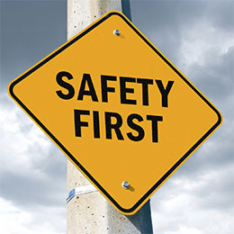
Marijuana & The Workplace
Jo McGuire
jo@jomcguire.org
www.jomcguire.org

