Slide 1

Severe Weather Preparedness
Presented by:
Springfield Twp. Fire Dept.
Josh Bradley & Mike wilson

Slide 2

Topics
Written emergency action plan
Employee emergency roles
Designating emergency exit routes/assembly areas, shelter-in-place locations
Emergency alarm/notification system
Training and drills
How to plan for “outdoor workers” and any other special hazard considerations

Slide 3
Written Emergency Action Plan
Important to have in place to ensure Swift and effective response in severe weather.
Outline role of each employee within the action plan
Know employee limitations
define clear roles and responsibilities prior to emergencies
Display the action plan in a readily accessible area
  By each egress door
  Designate and LABEL BUILDING SHELTER LOCATIONS
Ensure that each employee has read and understands the plan before the event of any incident
SUBMIT PLAN TO LOCAL FIRE DEPARTMENTS TO INCORPORATE IN THEIR PRE-PLANS

Slide 4


Minimum OSHA Requirements for EAP’s
At a minimum, the plan must include but is not limited to the following elements [29 CFR 1910.38(c)]:
Means of reporting fires and other emergencies
Evacuation procedures and emergency escape route assignments
Procedures for employees who remain to operate critical plant operations before they evacuate
Accounting for all employees after an emergency evacuation has been completed
Rescue and medical duties for employees performing them
Names or job titles of persons who can be contacted

Slide 5
EMERGENCY ACTION PLANS
Steps to creating an EAP:
Assess risks
Research regulations ( REQUIREMENTS)
Manage response plans
Evaluate resources
Document the plan
Train and prepare

Slide 6
EMERGENCY ACTION PLANS
Elements of an EAP:
Risk assessment
Emergency response team
Evacuation procedures
Emergency communication
First aid and medical assistance
Testing and updating the plan

Slide 7
EMERGENCY ACTION PLANS
Things to include in your EAP:
Evacuation routes
Who will be in charge during an emergency
Individual roles and responsibilities
Threats, hazards, and protective actions
Notification, warning, and communications procedures
Means for locating family members in an emergency
Emergency shutdown procedures

Slide 8
EMERGENCY ACTION PLANS
Communicating your EAP:
All employees
Visitors
Vendors
Contractors
You should also distribute the plan to emergency personnel, such as the fire department, designated emergency management, and supervisory staff.

Slide 9
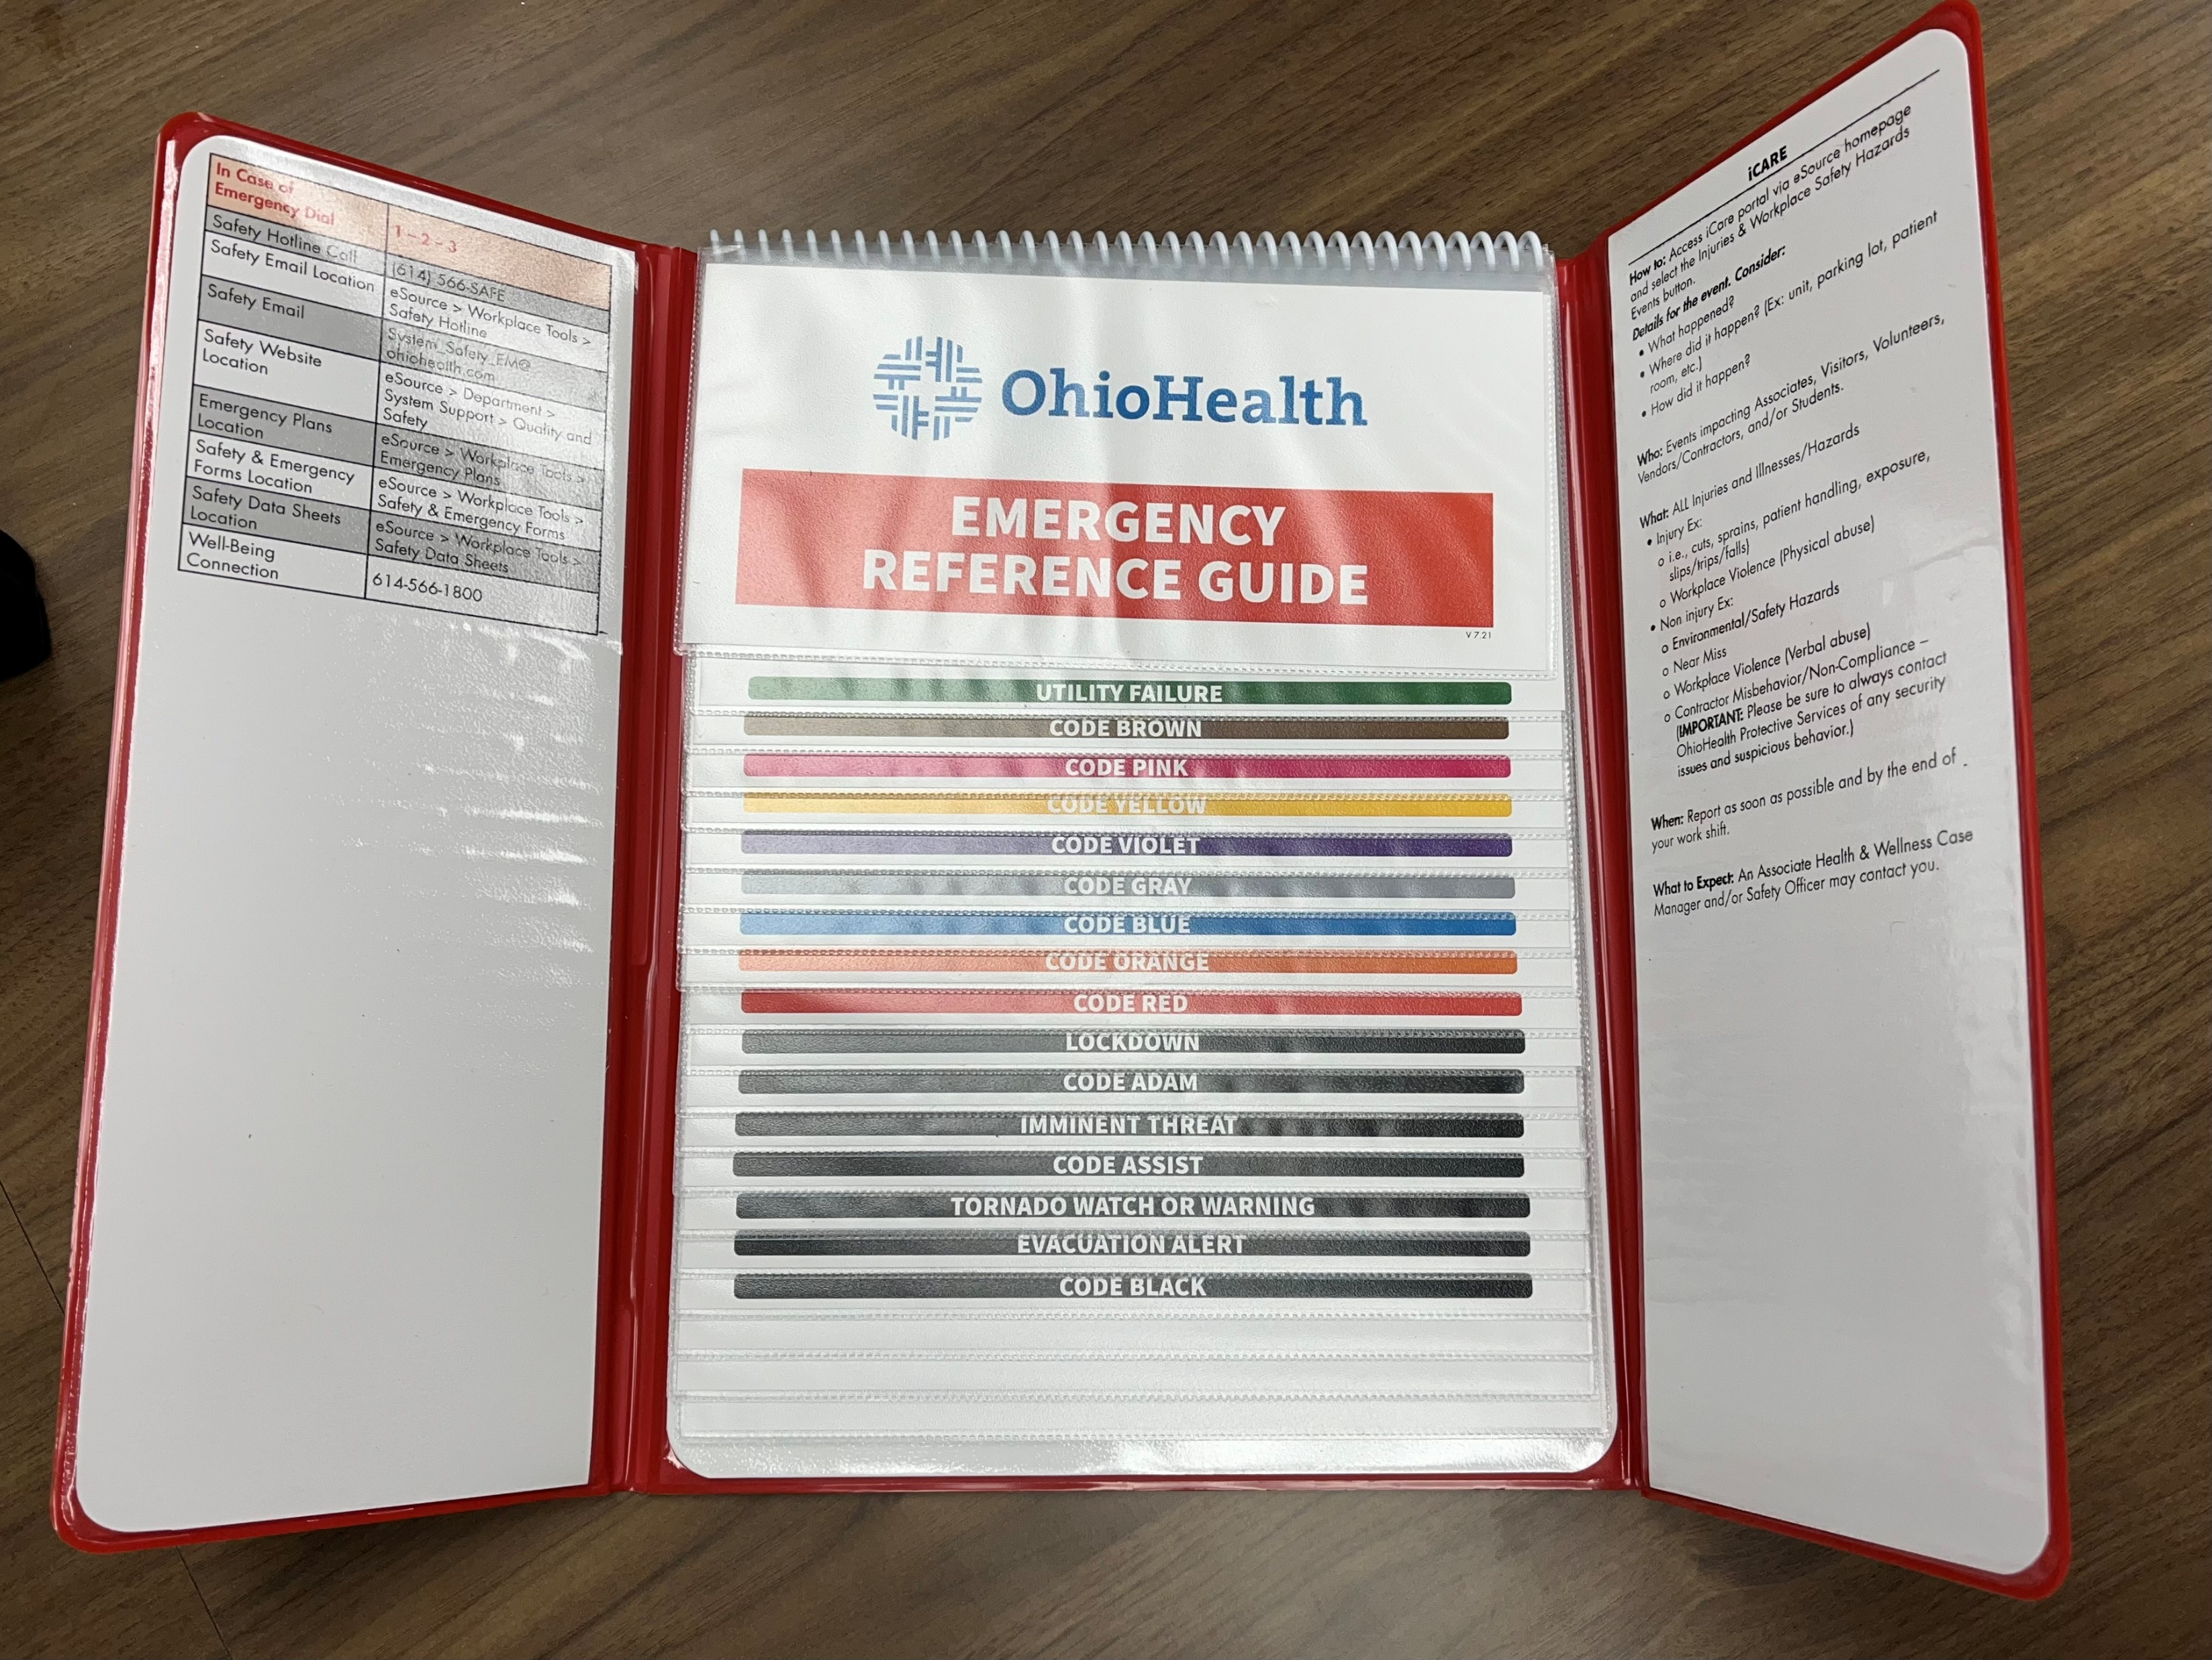
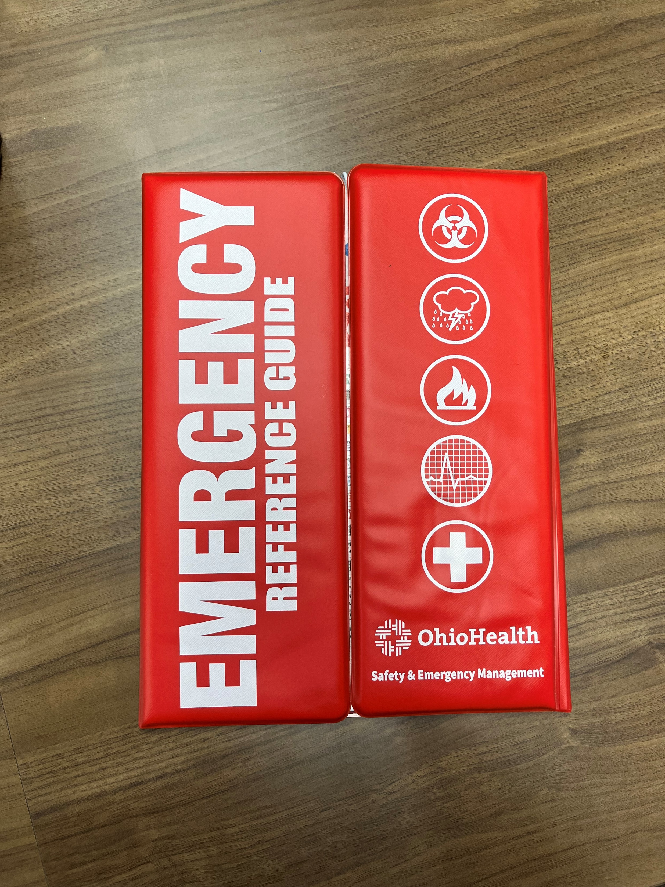

Slide 11
Fire Department Pre-Plans
Pre-Plan Information:
Owner Operator Information
Emergency Contact Information
Business Information: Shifts, number of employees on each Shift
Building Information: Construction Materials, number of floors, Attic Access, Basement Access, Sq. Footage
Fire Alarm Present? Location of Fire Alarm. Sprinklers Present?
Utility Type / Utility Shut off Locations
Hazardous Materials on site / Storage Locations
Fire Hydrant Locations
Fire Department Connection Location
Storm Shelter Locations
Evacuation / Re-Unification Sites
Business Floor Plan
Site Map

Slide 12
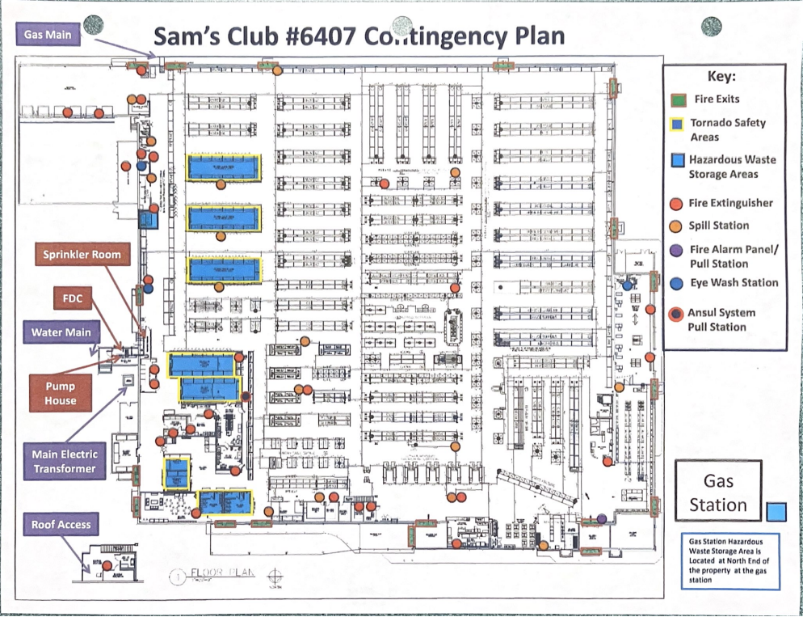
Pre-Plans

Slide 13
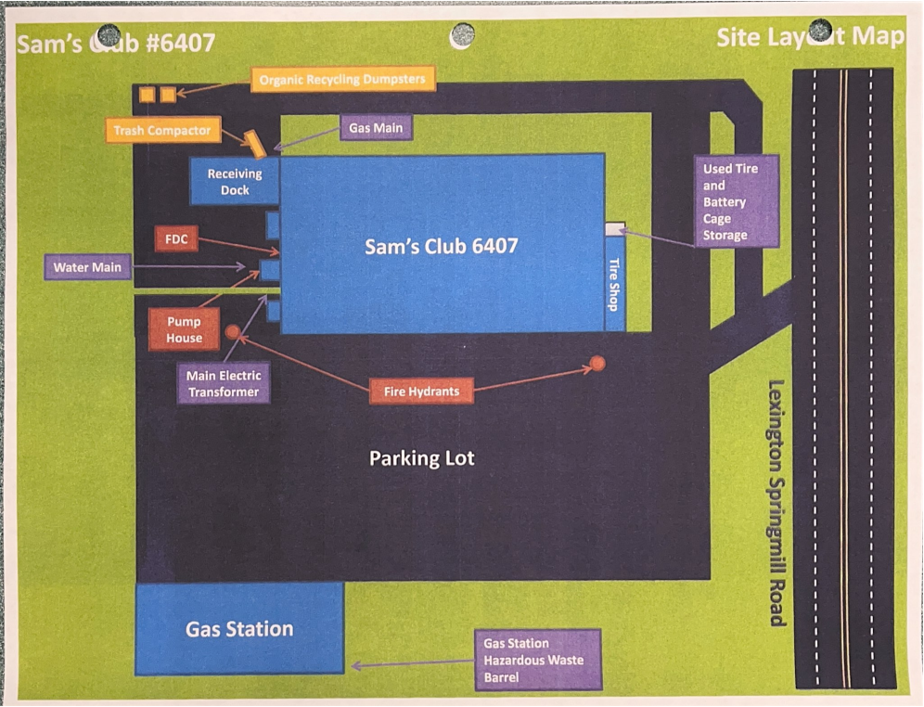
Pre-Plans
N

Slide 14
Roles of employees
EMERGENCY COORDINATOR (MINDSET- NEEDS TO HAVE A SAFETY MINDSET)
  RESPONSIBLE FOR LEADING IN ANY EMERGENCY
  SHOULD KNOW ROLES AND ASSIGNMENTS OF OTHER STAFF (ABLE TO DESIGNATE SAFETY ROLES)
  SHOULD BE FAMILIARIZED WITH ACTION PLANS IN CASE OF SEVERE WEATHER
  COORDINATE WITH RESPONDING EMERGENCY PERSONNEL
ACCOUNTABILITY
  RESPONSIBLE FOR HEAD COUNT OF ALL EMPLOYEES
  HAVE LIST OF EMPLOYEES ON SHIFT TO REFERENCE
  BE AWARE OF ANY NON-EMPLOYEES DURING THE INCIDENT

Slide 15
EMERGENCY ROUTES
Establish routes of egress within the location
  Primary evacuation routes
  Secondary evacuation routes
  Be aware of all exits ( Keep Exit pathways free and clear of debris)
Locations for assisted rescue ( Designated Rescue Area, Assisted Living )
  Windows
  Balconies
  Roof access
Shelter in place locations / Health Care facilities / Move to separate areas
  Areas in building more protected from severe weather

Slide 16
Alarm system
Be familiar with your alarm system
  AUDIBLE, VISIBLE, DUCT DETECTOR ALARMS, SPRINKLER SYSTEM, WATER FLOW
Train supervisors on the system
  Familiarize employees with procedures involving the system, AND CONTACTING ALARM COMPANY
  IT IS IMPORTANT THAT NO EMPLOYEE RESETS THE ALARM PANEL PRIOR TO EMERGENCY RESPONSE

Slide 17
TRAINING AND DRILLS
IMPORTANT TO TRAIN ALL EMPLOYEES ON SEVERE WEATHER PROCEDURES
  TRAINING MUST BE PROVIDED TO ALL EMPLOYEES UPON HIRE
  REFRESHER TRAINING MUST BE CONDUCTED ANNUALLY AT MINIMUM
  PLAN SHOULD BE REVIEWED NO LESS THAN EVERY 2 MONTHS
  RECORD OF INsTRUCTION MUST BE MAINTAINED
  COPY OF THE PLAN SHOULD BE READILY AVAILABLE AT THE LOCATION

Slide 18
SPECIAL CONSIDERATIONS
OUTSIDE Employees
EAP’s should be shared with the job foremen of any contractors working on site
  NEAREST PLACE OF REFUGE
  SHELTER IN PLACE VS EVACUATION
  LOCATION DEPENDENT
  ACCOUNTABILITY IS ESPECIALLY IMPORTANT

Slide 19
Communication

Slide 20
Questions?

