Slide 1
The Marijuana Experiment
Medical Marijuana
In Ohio

Slide 2

Marijuana Status (Medicinal)
- 30 States and DC
California – 1996
Alaska – 1998
Oregon – 1998
Washington – 1998
Maine – 1999
Colorado – 2000
Hawaii - 2000
Nevada – 2000
Montana – 2004
Vermont – 2004
Rhode Island – 2006
New Mexico – 2007
Michigan – 2008
Arizona - 2010
DC – 2010
New Jersey – 2010
Delaware – 2011
Connecticut – 2012
Massachusetts - 2012
Illinois – 2013
New Hampshire – 2013
Maryland – 2014
Minnesota – 2014
New York – 2014
Pennsylvania – 2016
Ohio – 2016
Arkansas - 2016
Florida - 2016
North Dakota - 2016
West Virginia – 2017
Oklahoma - 2018

Slide 3

The Ohio Medical Marijuana Control Program
House Bill 523
Legalized September 8, 2016
Notes:
House Bill 523, effective on September 8, 2016, legalizes medical marijuana in Ohio. The Ohio Medical Marijuana Control Program will allow people with certain medical conditions, upon the recommendation of an Ohio-licensed physician certified by the State Medical Board, to purchase and use medical marijuana.

Slide 4

Ohio Medical Marijuana
Seed to sale system
Uses the OARRS system
State issued ID Card
18 years or older – minor patients have designated caregiver
No smoking
Required to give information to consumer
Only patients, caregivers and employees in the dispensary
No drive through windows or home delivery
Notes:
A dispensary must provide with all medical marijuana dispensed, accompanying material that discloses any pesticide applied to the marijuana plants and growing medium during production and process and that contains the following warnings:
“Warning: This product may cause impairment and may be habit-forming. Smoking medical marijuana is not permitted in the State of Ohio.”
“There may be health risks associated with consumption of this product.”
“Should not be used by women who are pregnant or breastfeeding.”
“For use only by the person named on the label of the dispensed product. Keep out of reach of children.” 5
. “Marijuana can impair concentration, coordination and judgment. Do not operate a vehicle or machinery under the influence of this drug.”
6. The toll-free telephone line established by the state board of pharmacy in accordance with section 3796.17 of the Revised Code
7. The text used on all accompanying material must be printed in at least 12- point font and may not be in italics.

Slide 5




House Bill 523
Recommendation for 90 days and valid for one year (six months if terminal)
Physician cannot recommend to himself or family
One hour of continuing education for physicians on medical marijuana required
Federal child-resistant effectiveness standards required
Report all medical marijuana dispensed in OARRS
Local communities can ban marijuana businesses
No smoking and no home grows

Slide 6
And More…
Board of Pharmacy must establish a program for vets and the indigent in obtaining medical marijuana
Physician must obtain training before certification
Doctor’s cannot recommend to themselves
Cannot be within 500 feet of a school, church, public library, etc.
15% of all dispensary licenses to “Blacks or African Americans, American Indians, Hispanic or Latinos and Asians”
All testing facilities are limited to colleges and universities for first year
  Central State and Hocking College
Financial Institutions established as closed-loop system for the medical marijuana program
  HB495
Notes:
The Board of Pharmacy must establish a program for vets and the indigent. Lower cost marijuana for these groups. Also, the financial system that the Ohio lawmakers have set up is

Slide 7

Who Regulates?
Dept. of Commerce
Ohio State Medical Board
Board Of Pharmacy
Manage the requirements for the economic functions of the industry
Adopt rules regarding the licensure of cultivators within 240 days after the Governor signs the bill
Specify when testing of marijuana will be conducted, as well as minimum amounts and distribution of test results
Create a licensure program for physicians prior to recommending marijuana to patients.
Adopt all rules for the dispensaries, including training requirements of employees of dispensaries
Specify the forms of using medical marijuana that are attractive to children
Specify by form and THC content, a maximum 90 day supply of medical marijuana that may be possessed
Establish the number of dispensary licenses that will be permitted.
Adopt other rules for implementation

Slide 8
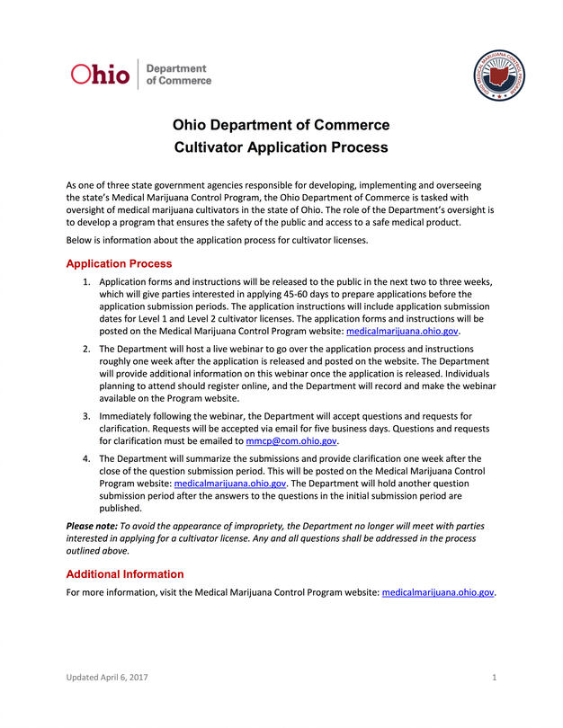
Cultivators
Medical Marijuana Control Program
Ohio Department of Commerce
Level II – 6,000 square feet or less – can expand another 3,000 sq.ft.
  14 Total
Level I – 50,000 square feet or less – can expand with another 25,000 sq.ft.
  16 Total
  Director can increase based on patient demand
Notes:
Number of Cultivator Licenses In accordance with rule 3796:2-1-01 of the Administrative Code, the Department may issue up to 12 Level I and 12 Level II cultivator provisional licenses before September 9, 2018. Application Acceptance Periods The application acceptance period will vary depending on the level of cultivator license. The acceptance periods for the cultivator license applications will be as follows: Level II Cultivator Applications: June 5, 2017 – June 16, 2017 Level I Cultivator Applications: June 19, 2017 – June 30, 2017 Applications shall be submitted only on weekdays during the hours of 9:00am EST and 5:00pm EST. Any applications or related documents delivered after 5:00pm EST on the last date of the applicable application acceptance period will not be accepted or considered.

Slide 9
Level I Cultivators
Buckeye Relief LLC (Eastlake, Lake County)
Grow Ohio Pharmaceuticals LLC (Newton Township, Muskingum County)
OPC Cultivation LLC (Huron, Erie County)
Riviera Creek Holdings LLC (Youngstown, Mahoning County)
Pure Ohio Wellness LLC (Springfield, Clark County)
Columbia Care OH LLC (Mt. Orab, Brown County)
Terradiol Ohio LLC (Canton, Stark County)
PharmaCann Ohio LLC (Village of Buckeye Lake, Licking County
Standard Wellness Company LLC (Gibsonburg, Sandusky County)
AT-CPC of Ohio LLC (Akron, Summit County)
Cresco Labs Ohio LLC (Yellow Springs, Greene County)
Parma Wellness Center LLC (Parma, Cuyahoga County)
Harvest Grows LLC (Hamilton Township, Lawrence County)
Harvest Grows LLC (Cleveland, Cuyahoga County)

Slide 10
Level II Cultivators
Fire Rock Ltd. (Columbus, Franklin County)
Fire Rock Ltd. (Canton, Stark County)
Fire Rock Ltd. (Arkon, Summit County)
FN Group Holdings LLC (Ravenna, Portage County)
Mother Grows Best LLC (Canton, Stark County)
OhiGrow LLC (Toledo, Lucas County)
Ancient Roots LLC (Wilmington, Clinton County)
Ohio Clean Leaf LLC (Dayton, Montgomery County)
Ohio Clean Leaf LLC (Carroll, Fairfield County)
Ascension BioMedical LLC (Oberlin, Lorain County)
Agri-Med Ohio LLC (Langsville, Meigs County)
Paragon Development Group LLC (Huber Heights, Montgomery County)
Hemma LLC (Monroe, Butler County)
Galenas LLC (Akron, Summit County)
Farkas Farms LLC (Grafton, Lorain County)
Pure OH LLC (East Palestine, Columbiana County)

Slide 11
Cultivation
Prevents someone from holding more than one cultivator license in Ohio
Can’t transfer license to another person without following process and approval
Renewal of licenses yearly
Must be at least 21 years old to work
Limits on pesticide and fertilizers
Packaging and labeling requirements
Do weekly inventory
Cultivator cannot sell directly to patient
Must begin growing by May, 2018

Slide 12
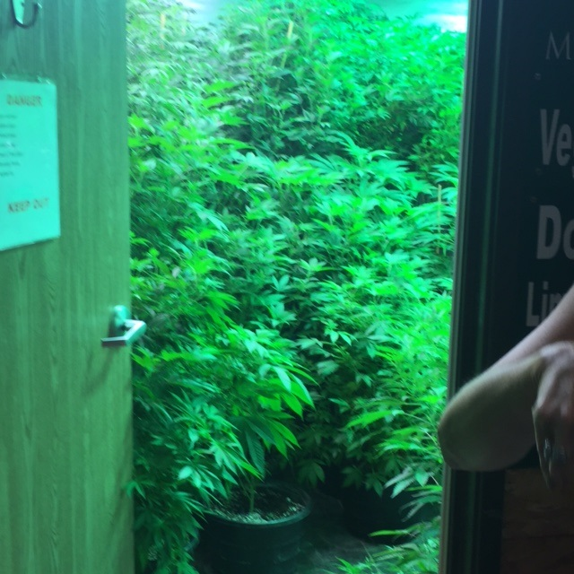
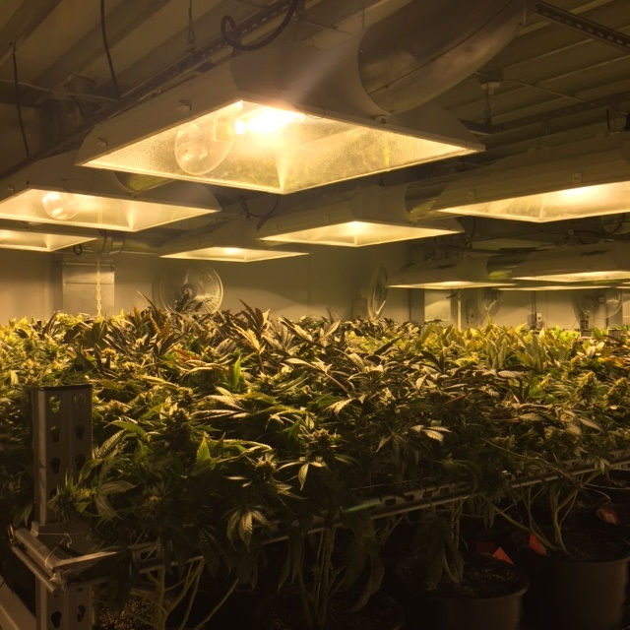
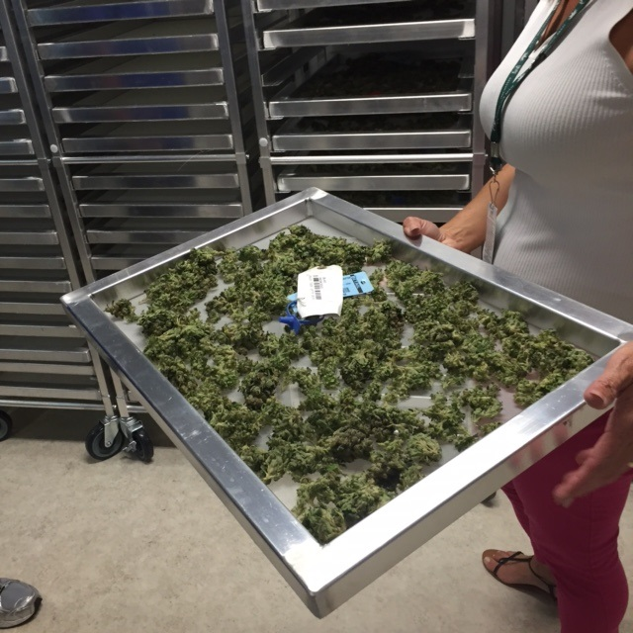
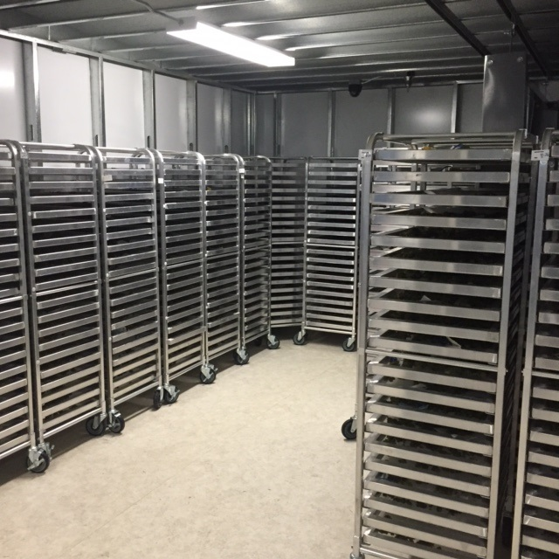
Marijuana Grow Houses

Slide 13
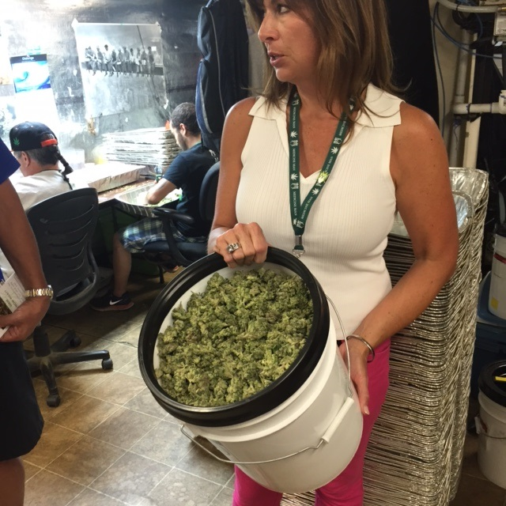
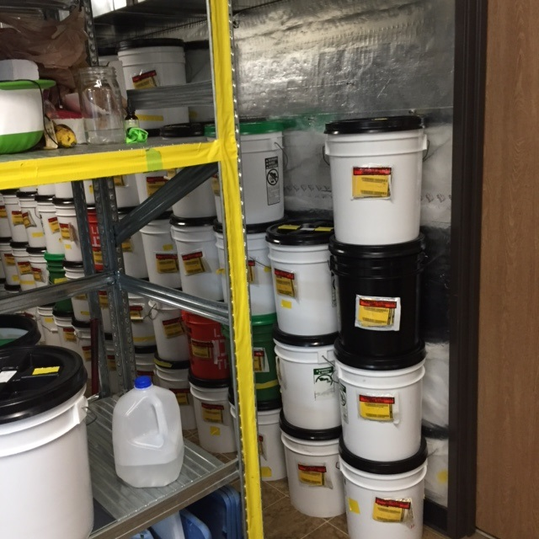
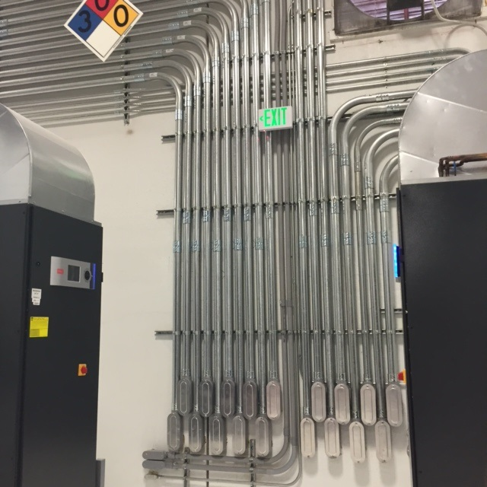
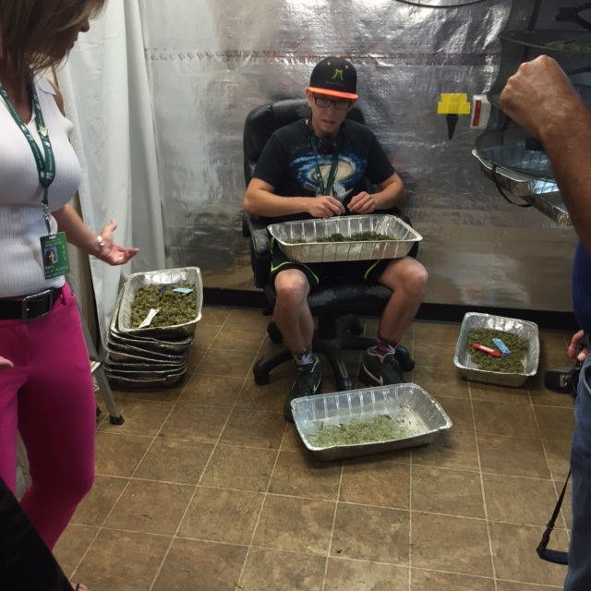
Marijuana Grow Houses

Slide 14
Qualifying Conditions
AIDS
Amyotrophic Lateral Sclerosis (ALS)
Alzheimer’s disease
Cancer
Chronic Traumatic Encephalopathy
Crohn’s Disease
Epilepsy or another seizure disorder
Fibromyalgia
Glaucoma
Hepatitis C
Inflammatory Bowel Disease,
Multiple Sclerosis
Pain that is either chronic and severe or intractable
Parkinson’s Disease
Positive status for HIV
Post-Traumatic Stress Disorder
Sickle Cell Anemia
Spinal Cord Disease or injury
Tourette’s Syndrome
Traumatic Brain Injury
Ulcerative Colitis.

Slide 15
Form and Method of Ingestion
Child resistant - packaging standards in 16 C.F.R.1700.15 – poison prevention packaging standards
Plant material – up to 35%
Oils/Edibles – up to 70%
Tier I medical marijuana – THC content of 23% or less
Tier II medical marijuana – THC content of more than 23% to no more than 35%
Forms:
  Oil, tincture, capsule, edible
  Metered oil or solid preparation for vaporization
  Patches for transdermal administration
  Plant material for vaporizing devices
  If new forms, they must be approved by state board of pharmacy

Slide 16

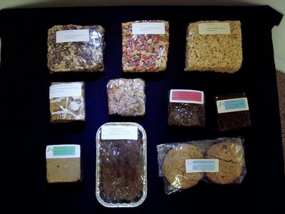
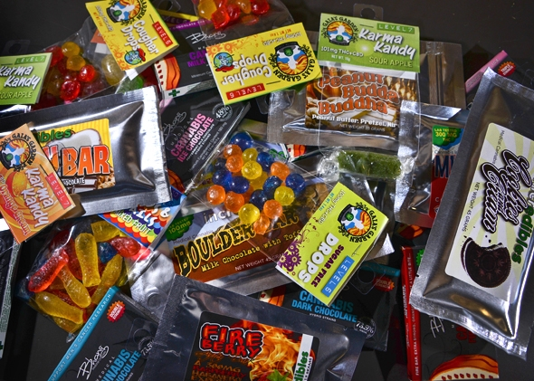

Ohio Approved

Slide 17
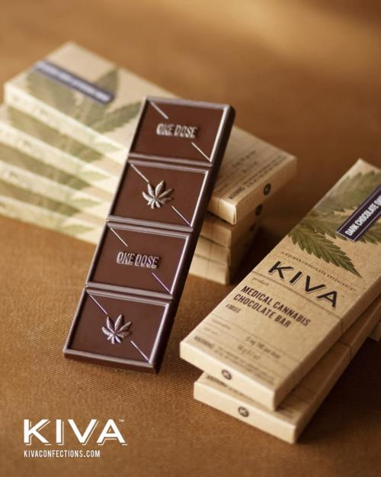
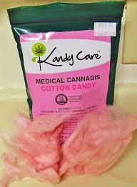
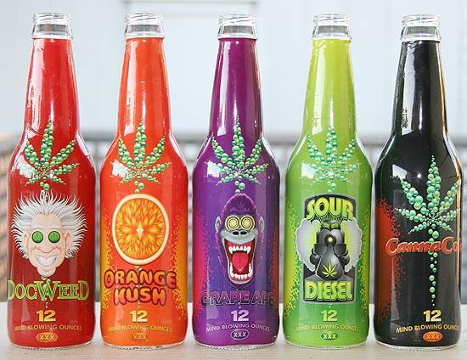

Marijuana Edibles

Slide 18

Cannabinoid Hyperemesis Syndrome
Identified in 2009
Cannabis use for years and on a weekly basis
Began young
Symptoms
Severe nausea and vomiting
Vomiting in cycle over a few months
Colicky abdominal pain
Short Term Fix
Immersion in hot water
Long Term Fix
Quit cannabis use

Slide 19
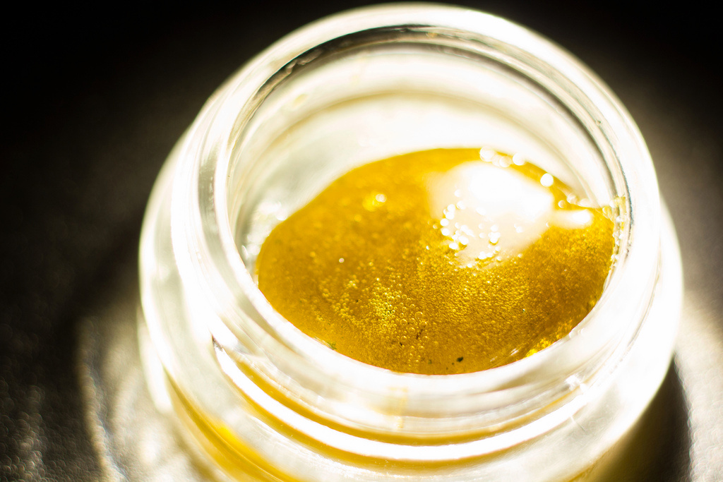
Marijuana Transformation: The High
Blogs have called it the “future of cannabis”
Can Exceed 80% THC
Hallucinations
Immediate high – edibles take about 30-45 minutes
Described as an intense experience, even for seasoned marijuana users

Slide 20
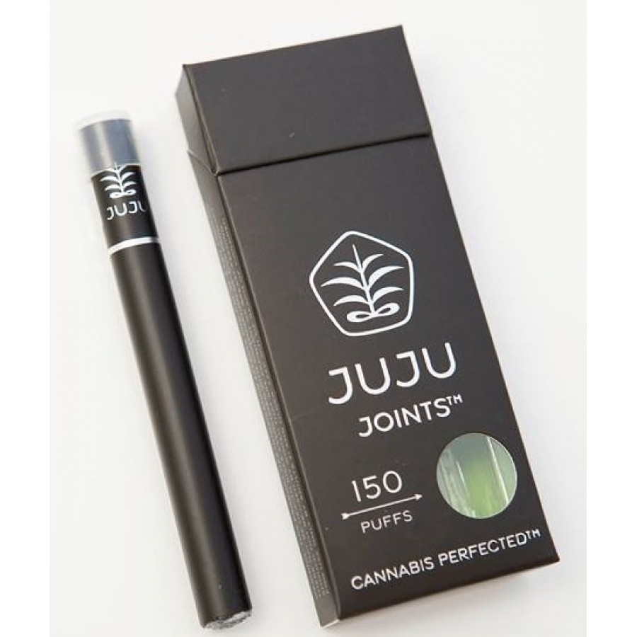
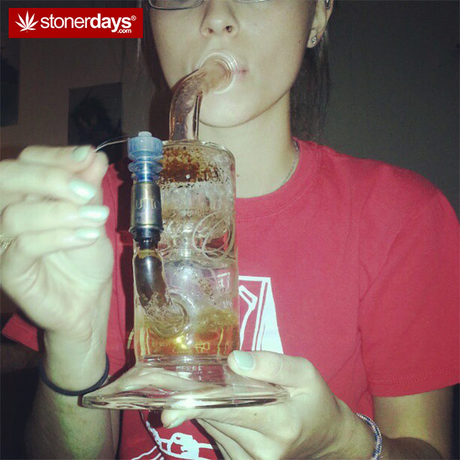
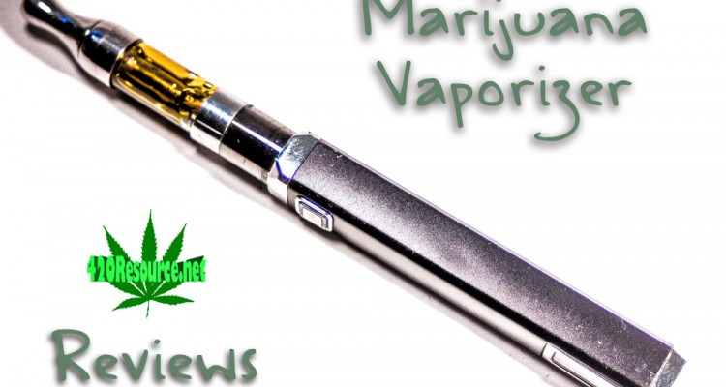
Dabbing and Vaping

Slide 21
Prohibited Products
Resemblance to a cartoon character, child’s fictional character, pop culture figure
Resemblance to commercially available candy
Design or object recognized as appealing to or used by children
Bears, animals, caricatures or cartoon rendering
Anything that may target those under 18 years old
Characterizing flavors use for vaporization
No vaporization for patients under 18

Slide 22
Processors
Up to 40 processors to start – more can be added if needed after 9/9/2018
Cannot be within 500 feet of prohibited facility
  185.48 – Ohio Grown Therapies, LLC (Johnstown, Licking County)
  182.00 – Fire Rock Processing Ltd. (Columbus, Franklin County)
  177.28 – Ohio Green Grow LLC (Toledo, Lucas County)
  176.72 - Greenleaf Therapeutics, LLC (Middlefield, Geauga County or Willoughby, Lake County) *
  172.20 – Grow Ohio Pharmaceuticals, LLC (Newtown Township, Muskingum County)
  156.52 – Standard Farms Ohio LLC (Garfield Heights, Cuyahoga County)
  155.32 – Corsa Verde, LLC (Columbus, Franklin County)

Slide 23
Product labeling
Child proof package
Label on every package with information on origin
Total weight in grams
Where and who tested
Complete CBD profile including THC
Expiration date - one year from date of manufacture
All ingredients in edibles
"This product is for medical use and not for resale or transfer to another person. This product may cause impairment and may be habit-forming. This product may be unlawful outside the State of Ohio."
Notes:
A processor distributing medical marijuana to a dispensary shall meet the following requirements: (1) A processor shall place medical marijuana in a child-proof, tamper-evident, light-resistant package approved by the department prior to distribution to a dispensary. Approved packaging shall maintain the integrity and stability of the medical marijuana, and shall comply with the rules promulgated by the state of Ohio board of pharmacy pursuant to Chapter 3796. of the Revised Code. (2) A label shall be affixed to every package and state in legible English: (a) The name and license number of the cultivator where the packaged plant material was cultivated or the name and license number of the processor where the medical marijuana products were manufactured; (b) The name and license number of the dispensary facility receiving the shipment; (c) The product identifier; (d) The registered name of the medical marijuana strain or medical marijuana product that was registered with the department; ***DRAFT - NOT FOR FILING*** 20 (e) A unique batch or lot number as defined in paragraph (A) of rule [3796:1-1-01] of the Administrative Code that will match the medical marijuana or medical marijuana products with a batch or lot, in order to facilitate any warnings or recalls the department deems appropriate; (f) The dates of manufacture, final testing, and packaging; (g) The total weight in grams of medical marijuana or medical marijuana products in each package; (h) The name and license number of the independent testing laboratory that performed the required tests on the batch or lot from which the medical marijuana or medical marijuana products in the package were taken; (i) The laboratory analysis and cannabinoid profile, including the percentage content by weight or total milligrams and milligrams per unit for: (i) Delta-9-tetrahydrocannabinol (THC); (ii) Delta-9-tetrahydrocannabinolic acid (THCA); (iii) Cannabidiol (CBD); and (iv) Cannabidiolic acid (CBDA). (j) The expiration date, which shall not exceed one calendar year from the date of manufacture; (k) If the product is edible, the following additional information: (i) A list of all ingredients and sub ingredients, providing that all ingredients comply with the standards of identity under rule 901:3-1-12 of the Administrative Code; (ii) A list of all major food allergens as identified in 21 USC § 343; and (iii) A statement with the following language: "Caution: When eaten or swallowed, the effects and impairment caused by this drug may be delayed." (l) If a marijuana extract was used in the manufacture of the product, a disclosure of the type of extraction process and any solvent, gas, or other chemical used in the extraction process or any other compound added to the extract; and (m) A statement with the following language: "This product is for medical use and not for resale or transfer to another person. This product may cause impairment and may be habit-forming. This product may be unlawful outside the State of Ohio." (B) A processor that elects to or is required to determine portions for an edible medical marijuana product under rules promulgated by the state of Ohio board of pharmacy pursuant to Chapter 3796. of the Revised Code shall apply a universal symbol that denotes that the product contains medical marijuana as an ingredient, as determined by the department, to each portion of the medical marijuana product, in accordance with the

Slide 24
Dispensaries
60 Provisional Licenses could be awarded – only 57 will be awarded
10 dispensaries in NW Ohio (2 potential dispensaries in District 1 – Ashland, Erie, Huron and Richland Counties)
Board of Pharmacy will consider more based on need – at least once a biennial
5 licenses max for dispensary owners
Open a minimum of 35 hours a week – 7:00 am to 9:00 pm
Cannot be within five hundred feet of a school, church, public library, public playground, or public park
Notes:
After September 8, 2018 and in accordance with division (B) of section 3796.05 of the Revised Code, the state board of pharmacy shall consider the population of this state, the number of patients seeking to use medical marijuana and the geographic distribution of dispensary sites in an effort to ensure patient access to medical marijuana. The state board of pharmacy shall consider these factors at least once each biennial licensing term to determine whether a sufficient number of medical marijuana dispensaries exist.

Slide 25


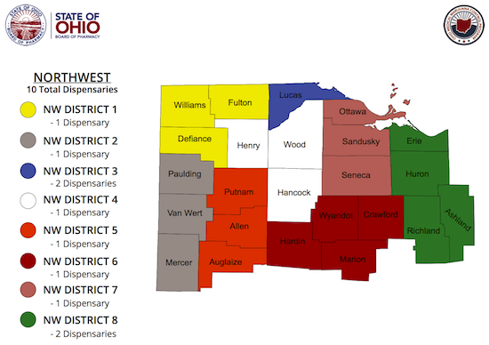
Dispensaries in Richland County
- 0 Dispensaries
No one applied in Richland County
No approved dispensaries in District 1
Only one application in District 1 – Defiance (Cannabiz – not chosen)

Slide 26
Advertising
All must be approved through the Board of Pharmacy
Marijuana cannot:
  Be within 500 feet of prohibited facility
  Be targeted to children
  On billboards
  On radio or broadcast
  On handheld or portable sign
  Hand out flyers or literature in public places
  Displayed on public transit vehicles

Slide 27
Ads and Promotions
No cartoon characters
Any apparel or merchandise marketed to youth under 18
No slang – only medical registered name
False or misleading statements
Obscene or indecent
Encourage use for anything other than specified conditions
No illuminated signs

Slide 28


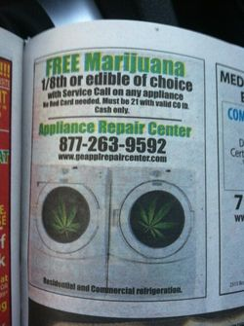

… And In Print

Slide 29
Patient / Caregivers
Registration Fees: Patient, $50 Caregiver, $25
Bona fide relationship with doctor and has a qualifying condition
Registration to Ohio State Board of Pharmacy
Proof of being an Ohio citizen
Must renew annually
Can purchase a 90 day supply in 90 days
Card valid for one year/6 months if terminal
Must carry registration card any time they have it with them
Must be in original containers

Slide 30
90-Day Supply –
OAC 3796:8-2-04
A patient and a patient's caregiver(s) may collectively purchase no less than a whole day unit at a single time. A whole day unit shall equal the following amounts for each authorized form of medical marijuana:
(1) One-tenth of an ounce (two and eighty-three hundredths grams) of plant material;
(2) Two-hundred ninety-five milligrams of THC contained in a patch, lotion, cream, or ointment;
(3) One hundred ten milligrams of THC contained in an oil, tincture, capsule, or edible for oral administration;
(4) Five hundred ninety milligrams of THC contained in oil for vaporization.

Slide 31
90-Day Supply –
OAC 3796:8-2-04
(B) A patient and the patient's caregiver(s) may collectively purchase, within a ninety-day period, no more than a ninety-day supply. A ninety-day supply may consist of multiple forms of medical marijuana, but the total ninety-day supply shall not exceed a ninety-day supply whether purchased as a single form or aggregated across forms. A ninety-day supply is defined by form as follows:
(1) Plant material:
(a) No more than eight ounces (two hundred twenty-six and eight-tenths grams) of tier I medical marijuana;
(b) No more than five and three-tenths ounces (one hundred fifty and three-tenths grams) of tier II medical marijuana.
(2) No more than twenty-six and fifty-five-hundredths grams of THC content in patches for transdermal administration or lotions, creams, or ointments for topical administration;
(3) No more than nine and nine-tenths grams of THC content in oil, tincture, capsule, or edible form for oral administration;
(4) No more than fifty-three and one-tenths grams of THC content in medical marijuana oil for vaporization.

Slide 32
90-Day Supply –
OAC 3796:8-2-04
(C) Notwithstanding paragraphs (A) and (B) of this rule, a patient who is diagnosed with a terminal illness and the patient's caregiver(s) may collectively purchase, within a ninety-day period, no more than a ninety-day supply. A ninety-day supply may consist of multiple forms of medical marijuana, but the total ninety-day supply shall not exceed a ninety-day supply whether purchased as a single form or aggregated across forms. A ninety-day supply is defined by form as follows:
(1) Plant material:
(a) No more than ten ounces (two hundred eighty-three and five-tenths grams) of tier I medical marijuana;
(b) No more than six and six-tenths ounces (one hundred eighty-seven and one-tenths grams) of tier II medical marijuana.
(2) No more than thirty-three and three-tenths grams of THC content in patches for transdermal administration or lotions, creams, or ointments for topical administration;
(3) No more than eleven and seven-tenths grams of THC content in oil, tincture, capsule, or edible form for oral administration;
(4) No more than sixty-five and seven-tenths grams of THC content in medical marijuana oil for vaporization.

Slide 33
Caregiver
Must be 21 years old – unless a minor’s parent, then at least 18
Patient can have no more than 2 caregivers
Caregivers can have no more than 2 patients
Can purchase no more than a 90 day supply in 90 days

Slide 34
Physician
Active, unrestricted license to practice medicine and surgery or osteopathic medicine and surgery under section
Access to the OCARRS systems
No disciplinary actions
2 hour approved continuing medical education
No ownership in a marijuana company
Maintain a complete patient history and medical record
Notes:
) The applicant has completed at least two hours of continuing medical education in a course or courses certified by the Ohio state medical association or the Ohio osteopathic association that assist physicians in both of the following: (a) Diagnosing qualifying medical conditions as defined in Section 3796.01 of the Revised Code; (b) Treating qualifying medical conditions with medical marijuana, including the characteristics of medical marijuana and possible drug interactions.

Slide 35
Testing Laboratory
The director of the department of commerce or the director’s designee may issue a provisional license to conduct laboratory testing of medical marijuana in accordance with the criteria listed in section 3796.09 of the Revised Code to an institution of higher learning that meets all of the following conditions: (1) The institution is public, and is located in the state of Ohio; and (2) The institution has the facilities and resources necessary to conduct testing in accordance with the standards and procedures established in rules adopted by the department under 3796.03 of the Revised Code

Slide 36
Taxes in Ohio
0.0

Slide 37

Questions?

