Slide 2
BWC Overview: Programs, Rating Plans, Grants & more!
Stacy Harrington
Regional Business Consultant
Northwest Ohio

Slide 3
Agenda
BWC Overview
Premium Calculation
BWC Rating Plans & Programs
BWC Grants
Office of Safety Services

Slide 4
BWC Overview
Created by Ohio Workers' Compensation Act of 1913
Provides no-fault insurance
Exclusive remedy
Protects both employers and employees

Slide 5
Bureau of workers’ compensation
Investigate and determine claim allowance
Manage lost time benefits
Adjudicate additional conditions
Determine eligibility for rehabilitation services
Assist with bringing the claim to resolution
MCO oversight
Premium collection
Office of Safety Services

Slide 6
Managed care organization
Every employer must have an MCO
BWC pays the MCO
Communicates directly with injured worker, provider and employer
Manages medical costs
Approves medical treatment
Educate and assist employers/providers with return-to-work initiatives
Open enrollment every 2 years

Slide 7
Third Party Administrator
Private contract between employer and TPA
Assists in managing claims for employer
Represents employers at Industrial Commission and adjudication hearings

Slide 8
Ratemaking
BWC must collect enough money in premium to pay out claim costs
Costs must be equitable divided among all employers
Factors that determine what an employer pays in premium
Manual Classification
Payroll
Claim History

Slide 9
Current Experience Periods
Private Employer: July 1, 2025 to June 30, 2026
Claims costs and payroll from policy years 2019, 2020, 2021 and 2022
Claims costs and payroll from calendar years 2019, 2020 2021 and 2022
Snapshot Date
September 30, 2024
Public Employer: January 1, 2025 to December 31, 2025
Snapshot Date
March 31, 2024

Slide 10
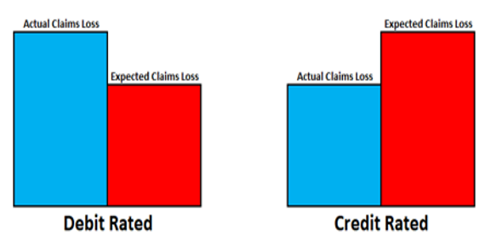
Experience Modifier
Experience Modifier compares actual claims costs to expected claims costs
This determines the percentage of the base rate an employer will pay

Slide 11
BWC Program and Grants Eligibility
Be a state-fund private or public employer taxing district
Reporting payroll to BWC
Be in good standing with BWC
Have active coverage
No more than 40 days of lapse (cumulative over past 12 months)
Be current on all payments
Completed all outstanding payroll true-up reports
Self-insured and clients of either a PEO or AEO generally are not eligible

Slide 12
BWC Alternative Rating Programs
Group Experience Rating Program
Group Retrospective Rating Program
Individual Retrospective Rating Program
Large/Small Deductible Program
Claim Impact Reduction Program

Slide 13
BWC rebate programs
$15,000 Medical Only Program
Substance Use Prevention & Recovery Program
Early Payment Discount
Safety Council Rebate Program
Risk Management Essentials Program

Slide 14
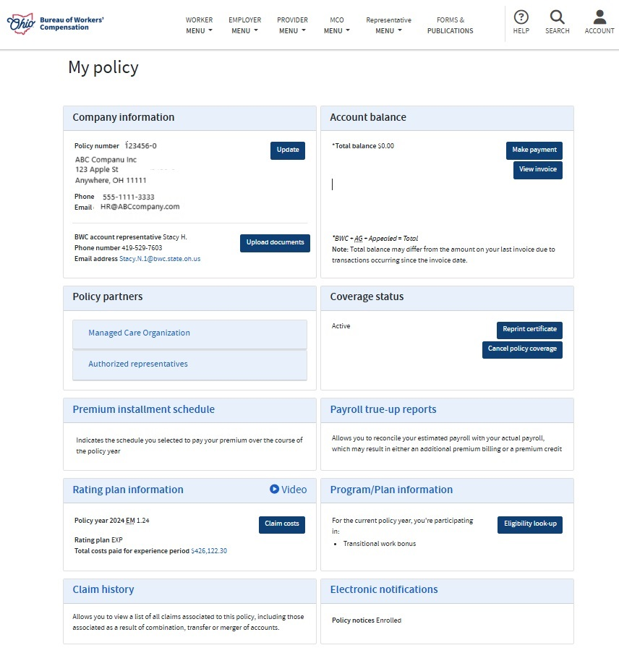
Assistance with Programs

Slide 15

Better You, Better Ohio!
Basic incentives
Health risk assessment & biometric screen – worker incentive $75
Additional $50 when using the physician form for biometric screen
Optional incentives
$50 by completing physical activity (5,000 steps or 30 minutes of physical activity per day for any 50 days within a quarter)
$50 by completing three virtual group or personal coaching calls

Slide 16
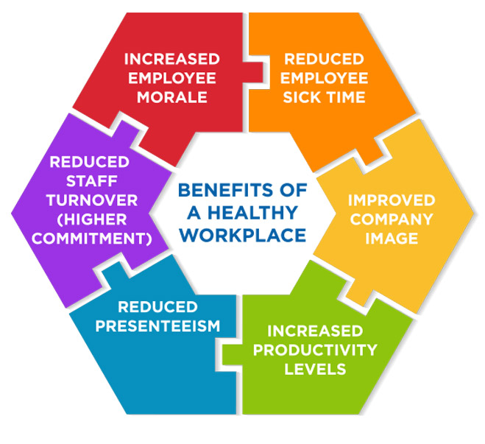
Better You, Better Ohio!
No administrative work
NO paperwork
NO application
NO annual reports or follow-up
Public employers Agriculture
Restaurant and food service Automotive repair and service
Transportation and trucking Construction
Trash collection Firefighters
Wholesale and retail Healthcare
Police and public safety Manufacturing

Slide 17
BWC Grants
Transitional Work Grant
Safety Intervention Grant
Firefighter Exposure to Environmental Elements Grant
School Safety and Security Grant

Slide 18
Transitional work Grant
BWC will pay 100% of Transitional Work Program development
Policy and procedure
Job Analyses
Supervisor training and employee education
Employers are eligible for a grant every 5 years
Ranges
11-49 employees – up to $3,700
50-199 employees – up to $6,800
200+ employees – up to $8,200

Slide 19
Safety Intervention grant
3-to-1 matching grant
Up to a maximum grant of $40,000
Employers are eligible every 3 years
To purchase equipment to substantially reduce or eliminate injures and illnesses
Must apply for the grant prior to purchasing the equipment
A list of unapproved purchases on BWC’s website

Slide 20
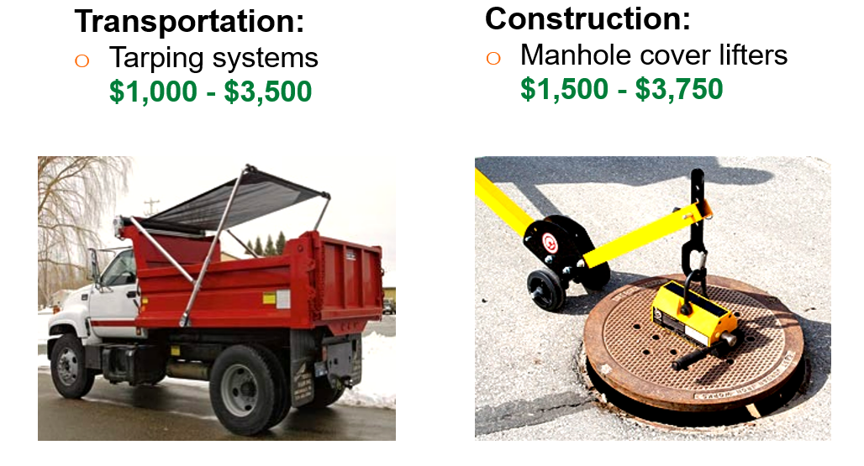
Safety Intervention grants

Slide 21
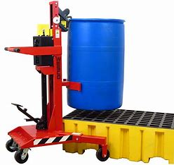
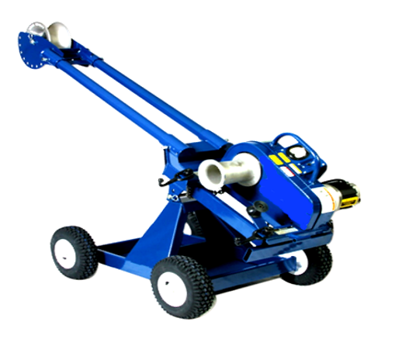
Safety Intervention grants
Drum Handling Equipment
$1,200 - $16,000
Cable Puller
$2,500 - $18,500

Slide 22
Firefighter Exposure to Environmental Elements Grant
Up to $15,000 in grant funding
Employers are eligible every 3 years
Payroll >= $500,000 receive a 5-to-1 matching grant
Payroll < $500,000 no matching requirement
May be used for:
Diesel exhausting system
Turnout extractors
Hoods with barrier protection
Washable structural fire fighting gloves
Recently expanded to include turnout gear for volunteer firefighters and EMS staff

Slide 23
School Safety and Security Grant
Maximum grant of $40,000
3-to-1 matching grant
Eligible every 3 years
May be used for:
Employee safety interventions
Incident response equipment
Building/grounds/transportation security
HVAC improvements/maintenance

Slide 24
BWC’s Office of Safety Services
Benefits to your company
No additional cost
Services designed to inform, educate and assist with your company’s loss-prevention activities
Consultative in nature – no fines or penalties
Customized services to meet your company’s needs

Slide 25
Safety consulting services
Hazard assessments
Safety program advice
Written program reviews
Training
Safety team evaluation and design

Slide 26
Industrial Hygiene Services
Air sampling
Noise sampling
Ventilation assistance
Confined space identification
Program assistance

Slide 27
Ergonomic services
Assessments related to material handling
Workstation design
Prevent musculoskeletal disorders and repetitive motion issues

Slide 28
Library Services
Find answers to your workplace safety and health questions
Provides information on workplace safety and health
Access to the most current safety regulations, standards, and codes
Direction to valuable sources of internet information
Availability of books, journals, magazines, and newsletters
Obtain videos via streaming

Slide 29
Training services
Webinars
On-Demand Online courses
Virtual Training Courses
Classroom courses

Slide 30

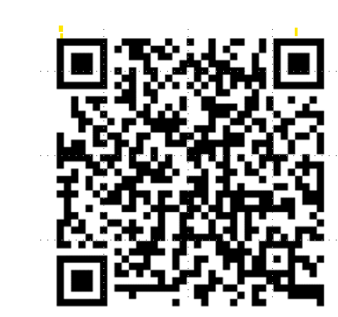
Dolly Parton’s Imagination Library of Ohio
All children from 0-5 years old in Ohio
One age-appropriate book at no cost to the family
Mailed directly once a month to the child’s home

Slide 31

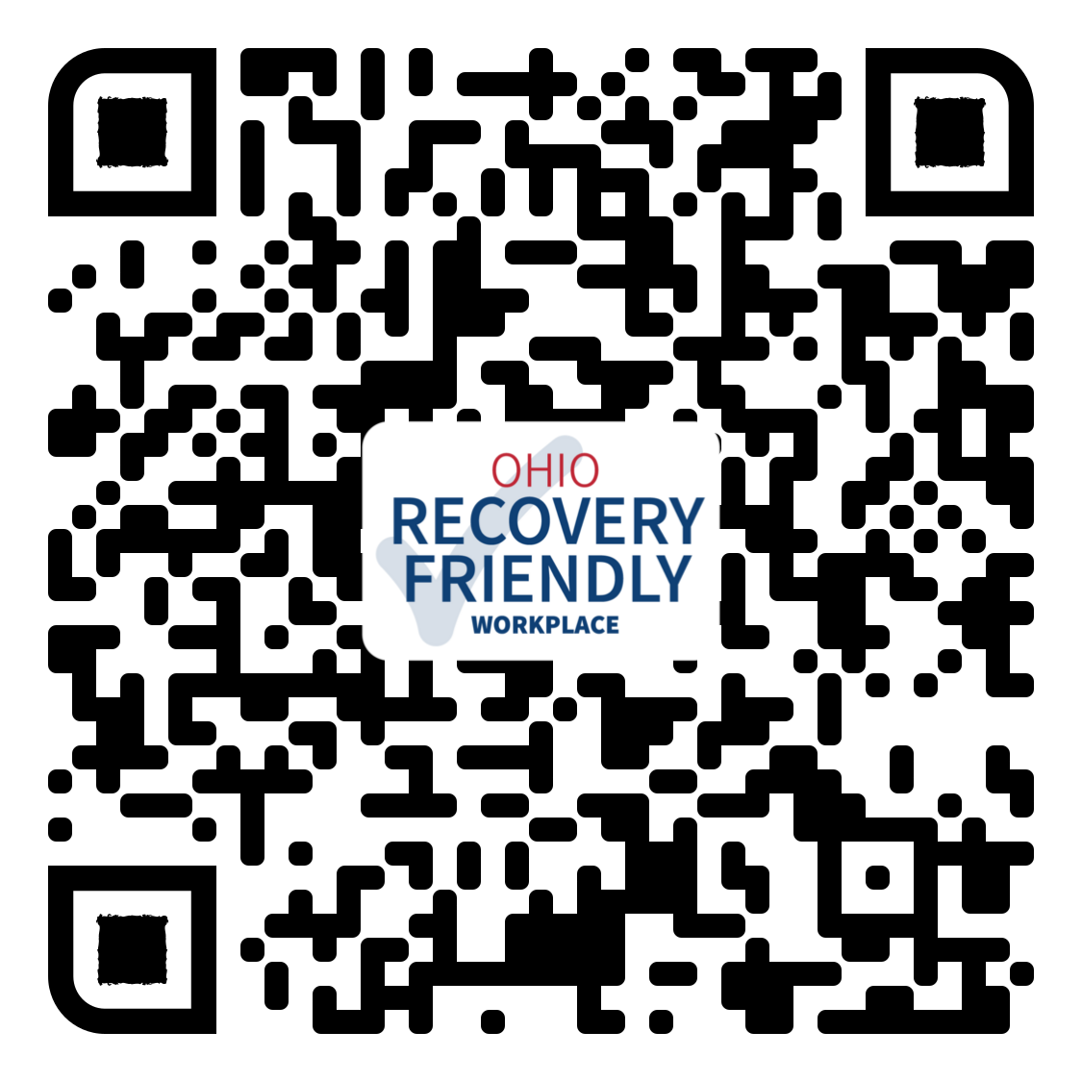
Recovery friendly workplace
The Recovery Friendly Workplace program helps employers:
Assist employees with mental health or substance use disorders to seek treatment.
Expand and retain their workforce.
Highlight their status as a recovery friendly business.
Remove barriers and stigma for individuals with mental health and substance use disorders.
Maintain connections with workers.
RecoveryFriendlyWorkplace.MHA.Ohio.Gov

Slide 32

988 Support Services
Trained crisis counselors/specialists
Free/confidential
24/7 access via call, text, or chat
Assistance to individuals who may be experiencing:
Suicidal thoughts or tendencies;
Substance use;
Mental health crisis; or,
Any other kind of emotional distress.

Slide 33
Questions?
Stacy Harrington
Regional Business Consultant
419-606-4617
Stacy.Harrington@bwc.ohio.gov

