Slide 1
Richland County, OH
Monday, APRIL 8, 2024
Totality start time: 15:12:23pm (3:12pm)
Observers will see approx. 3 minutes, 16.1 seconds
LAST TOTAL SOLAR ECLIPSE – 1806
NEXT TOTAL SOLAR ECLIPSE - 2444

Slide 2
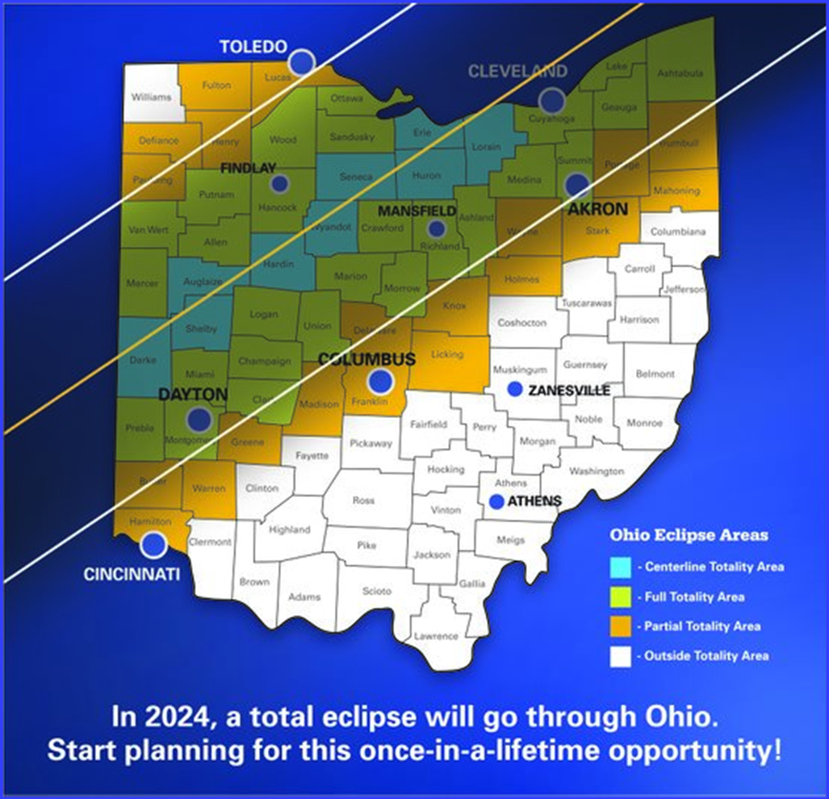
April 2024
Su Mo Tu We Th Fr Sa
1 2 3 4 5 6
7 8 9 10 11 12 13
14 15 16 17 18 19 20
21 22 23 24 25 26 27
28 29 30
APPROXIMATELY
250,000
visitors to
Richland County

Slide 3
11 states will experience TOTALITY
Approximately
31.5M
people in path of totality
TOTALITY will occur between NOON and 8PM

Slide 4
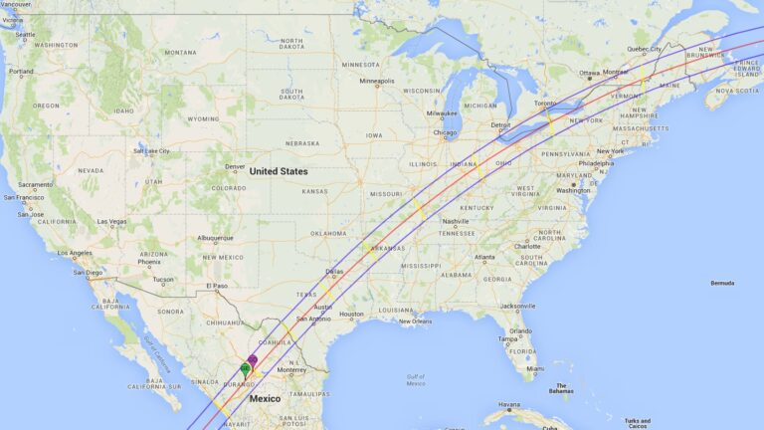
PATH
of
2024 ECLIPSE

Slide 5
WYOMING…
2017 Eclipse

Slide 6
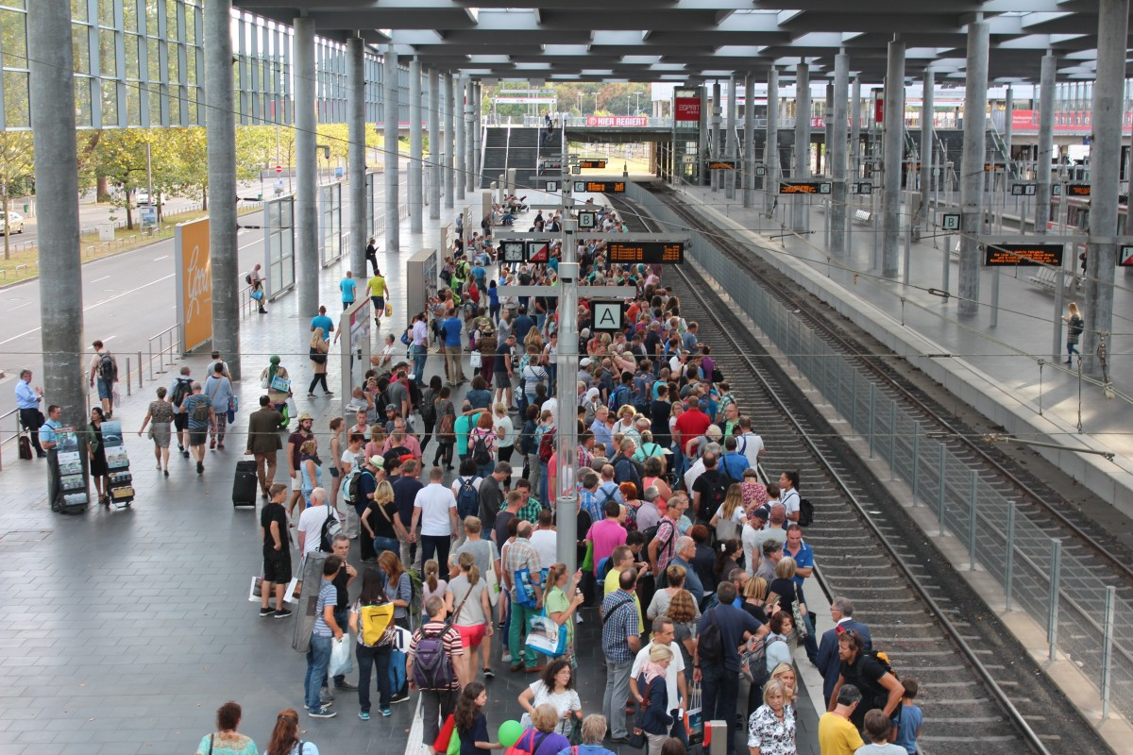
MISSOURI…
Totality occurred during school dismissal
Rest areas experienced 75% capacity during peak eclipse
Following totality, visitors left almost immediately – EVERYONE
wanted to leave at the same time !!
Experienced high volume of network/internet issues
2017 Eclipse

Slide 7
Our ECLIPSE plan of attack …
Engage many COMMUNITY partners in our planning
Community Awareness
Public Safety
Education
Public Health
Resources & Logistics
Viewing Sites

Slide 8
Our ECLIPSE plan of attack …
Create COMMUNITY AWARENESS CAMPAIGN for
residents, businesses, visitors
Marketing – social media, websites, brochures, etc.
Presentations
Local Govt, Civic Organizations
School Superintendents
City/Village/Township meetings
Neighborhood watch meetings
Community Events
County Fair
Amish Safety Day, Amish Buggy Day
Malabar Family Fun Day

Slide 9
Our ECLIPSE plan of attack …
Great ECONOMIC OPPORTUNITY for area
businesses – restaurants, hotels, local
attractions, etc.
IF WE ARE PREPARED!!
Businesses should keep in mind…
Shift change
Deliveries/shipments
Internet/computer issues

Slide 10
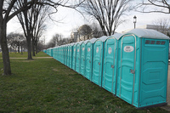
THINGS TO REMEMBER…
AVAILABILTY OF RESOURCES – Law Enforcement/EMS/Fire
TRAFFIC – altered traffic patterns, designated routes
COMMUNICATIONS – radio communications cell/internet connectivity
PRIVATE PROPERTY CAMPING – health department regs.
HOTELS/CAMPGROUNDS/REC AREAS – high demand
SPECIAL EVENTS – funerals/weddings/prom
SCHOOLS – school closures
PORT-A-POTS!!!

Slide 11
HOW YOU CAN HELP
Run errands, grocery shop early in the week
Get necessary Rx and medical supplies
Limit travel during the weekend
PREPARE FOR
TRAFFIC DELAYS
EVERYWHERE!!!

Slide 12
Simulation of the Total Solar Eclipse from Mansfield, Ohio
Eclipse Simulator Video Credit to Eclipise2024.org

Slide 13
OHIO EMA SOLAR ECLIPSE WEBSITE
https://ema.ohio.gov/media-publications/ohio-total-solar-eclipse/splash-page
RICHLAND COUNTY EMA…419-774-5686
https://www.richlandcountyoh.gov/departments/eclipse2024

