Slide 1
Stress: Learning Today for a Better Tomorrow
Presented by: Kristen Dickerson, PhD, MPH, RN, MLT(ASCP)
Statewide Health, Wellness, and Special Programs Manager-BWC

Slide 2
Objectives
Current situation
Types of stress
Symptoms of stress
Stress Management
Toolkit
Mindfulness
Health and Wellness
Teleworking tips

Slide 3

Current Situation
Pandemic
  Teleworking
  Isolation
  Possible illness
  Traumatic event
CHANGE
  Children at home
  Job status and security
  Routines and schedules
  Economy
  How we interact with people

Slide 4
Stress
Emotional or physical tension
Is a normal feeling
Your bodies reaction
  Challenge
  Demand
Acute or chronic
Stressor
Anxiety

Slide 5
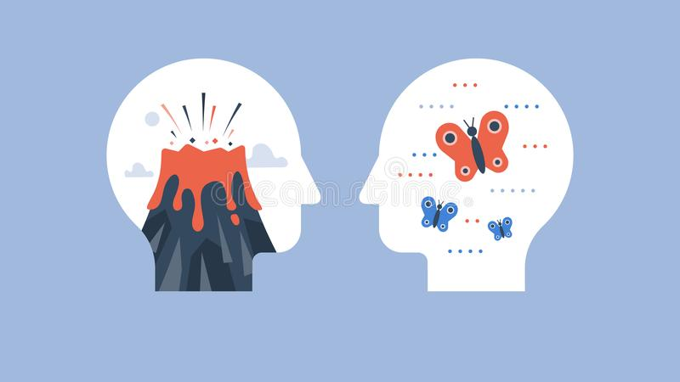
Stress
Acute Stress
  Short term stress
  Least damaging
  Can be positive
  Most Common
  Examples
    WebEx not working
    Call in number is wrong
    Late for a meeting

Slide 6
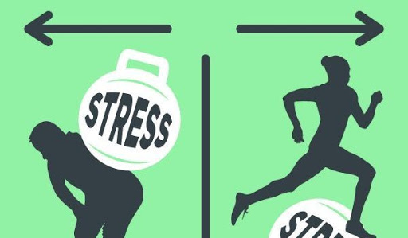
Stress
Chronic Stress
  Long term stress
    Emotional pressure
    Individual feels they have no
    or little control
  Association with traumatic events
  Chemicals in the body are released
    Corticosteroids
    Norepinephrine/epinephrine
    Build up over time
    Flight or fight all the time

Slide 7

Stress
Impacts of Chronic Stress
    High blood pressure (stroke)
    Damage to muscle (heart attack)
    Growth inhibition
    Suppress the immune system
    Anxiety, depression
    Headaches
    Sleep problems
    Concentration problems
    Weight gain

Slide 8

Symptoms
Change in bowel habits
Trouble sleeping/sleeping too much
Upset stomach
Use of drugs or alcohol
Change in weight
Forgetfulness
Tiredness
Inability to concentrate

Slide 9
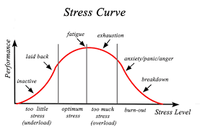
Classifications
Routine
Change
Traumatic event

Slide 10
Your Feelings
Feelings you may be experiencing
Sadness
Guilt
Loneliness
Isolation
IT’S OK TO HAVE THESE FEELINGS
Everyone is experiencing similar feelings right now
Time for processing
Fear
Anger
Despair
Panic
Anxiety
Confusion

Slide 11

Managing stress
Be observant
Talk to your provider

Slide 12

Managing stress
Regular exercise
  30 minutes a day
  Help boost your mood
  Helps you sleep better
Relaxing activities
  Meditation
  Breathing exercise
  Mindfulness

Slide 13

Stress management
Eat healthy
  5 fruits and veggies a day
  More food cooked at home
Sleep well
  Develop a sleep routine
  Stop electronics 60 minutes prior to bed
  Keep your bedroom for sleeping

Slide 14

Managing stress
Set goals and priorities
  Say no
  Note what you have accomplished
Stay connected
  Stay connected
  Consider community groups

Slide 15

Managing Stress
Be positive
  Assertive
  Accept that you can not control everything
  Write your feelings down
  Celebrate the small stuff

Slide 16

Toolkit: the four A’s
Avoid
  Take control of surroundings
  Avoid people
  Say no
  Ditch the list

Slide 17

Toolkit: the four A’s
Alter
  Ask for a change
  Communicate feelings
  Manage time better
  Limits in advance

Slide 18
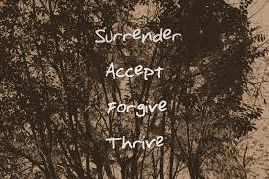
Toolkit: the four A’s
Accept
  Talk to someone
  Forgive
  Positive self-talk
  Learn from mistakes

Slide 19

Toolkit: the four A’s
Adapt
  Adjust standards
  Thought stopping
  Rethink the issue
  Adopt a mantra
  Create an assets column
  Look at the big picture

Slide 20
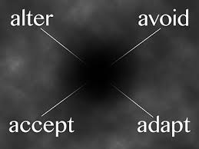
Thought Break
Think about it
  A true example
  What A would work
Notes:
This encourages movement and laughter, all of which release good chemicals in the brain. We will let people know to only participate to their ability. We may consider showing different screens of supervisors moving to encourage others.

Slide 21

Mindfulness
Quality of being aware
Mental state
  Focus awareness
  Accept feelings

Slide 22

Mindfulness
Aware of your thoughts
Stop immediate reaction
Being Mode
Aware of your needs

Slide 23

Mindfulness
Aware of emotions
Compassion
Reduces brain activity
Better able to focus
Switch your attitude to stress

Slide 24

Live mindfully
Mindful wakeup
Mindful eating
Mindful pause
Mindful workout
Mindful driving

Slide 25

Minute Activities
Yawn and stretch
Three hugs, three breaths
Stroke your hands
Mindfully eat
Clench and breath
STOP
Breath for a minute
Love/kind
Aspirations

Slide 26
Health and Well Being
Create new routines
Take time to disconnect
Accept negative emotions
It is ok
Write down your feelings
Remember self care
Schedule this every day: i.e.. take a walk, facetiming with friends, draw, listen to music
Play
Play games with family inside or out
Use this time to connect with family

Slide 27
Health and Well Being
Meditate
Complete mindful activities
Reduce exposure to social media
Avoid complaining and gossiping
You invite criticism and unwanted advice
You increase negative stress hormones

Slide 28
Tips for Teleworking
Have a morning routine
Try to have a schedule for you and children
Engage when you can by video
Schedule breaks
Get outside or at least leave your office space

Slide 29
Tips for Teleworking
Have a firm quitting time
Your office space is your office space
Only work from this space
The rest of your house should remain work free
When possible, the workplace should be outside of your bedroom
Share thoughts with co-workers

Slide 30
Resources
Click here for the Adult Resource page that the state has prepared.
There is information about mental health services, recovery and addiction support, health and fitness information, and resources for financial concerns as well.
Click here to be taken to the CDC website about managing stress and anxiety during the pandemic.
It offers information to help with children that may be experiencing stress as well.
Click here to be taken to the CDC website about dealing with a traumatic event.
It also offers resources for others in your family.
Click here to see SAMHSA and their information about mental wellbeing during an infectious disease outbreak.
Click here to watch a video that discusses stress and management.
They also have provided information here about dealing with a traumatic event.

Slide 31
Resources
Click here for information about sleep
Click here for information about nutrition
Click here for information about physical activity
Click here for more information about Mindfulness

Slide 32
Questions
Kristen Dickerson
K.dickerson.1@bwc.state.oh.us
Office: 614-466-7053
Cell: 614-512-2842

