Slide 1
Ergo in the Virtual World / Working from Home (Everyone isn’t feeling it)
Avita Health System - WorkWell
Jared Cass, OTR/L, CEAS I,II, TWD
Director – Employee Health and Occupational Medicine
jcass@avitahs.org
419-566-3888
Notes:
12
17

Slide 2
Working from Home
Hips, knees, elbows 90 degrees, wrist neutral
Move every 20 minutes
Eyes should be looking at top line of screen and an arm’s length away from the monitor
Feet on the floor with low back supported
Micro Breaks make all the difference
Vary your tasks if possible
Plan and Prepare – don’t procrastinate (stress)

Slide 3
Working from Home
The Next Posture is the Best Posture
All good - if in Moderation
Stretch – If it feels good, do it, Opp. Direction
Have a neighbor take a look
Morale – biggest contributor to injury
Set a Timer – Self assess, take a break, Stuck
Don’t Multitask
Keep a Schedule, a constant in this crazy world

Slide 4
Working from home? It will be so fun they said. Isn’t it GREAT!
To some it is…..to others…….
Cook for kids
Listen to “I’m bored” ALL DAY, not just in the evening
Watch the Dog
Listen to the TV, kids, rocket launchers, etc. in the background
Fix all the problems that seem to get fixed when you are not home
Get caught in PJ’s on a Zoom call – or worse – we won’t go there
Forget to unmute….or worse…..forget to mute
The dreaded Zoom echo
Social Isoloation
Recognize even the annoying coworkers were at least adult interactions
S T R E S S

Slide 5
Your body works more efficiently when not stressed
Ergonomics (Force, Frequency, Posture, Duration):
The study and utilization of anthropometric data to…..BORING
Adjusting the work station or the work process to fit the worker
Tilt Steering wheel
Plastic bags (handles) versus paper bags
A stack of paper to adjust the monitor height
However, as you may have heard, the leading pre-contributing factor to injury is…………
MORALE (STRESS)

Slide 6
Ergonomics (Restrictions) at work, home, etc.
Santa was grumpy last December 26th. When Santa ain’t happy, nobody is happy. When asked why, he moaned and groaned….
The job is just too much, especially as I get older.
Presents are bigger, heavier and there are more of them
The chimney is smaller…..ok Santa….whatever
I never did well with confined spaces anyway
Sitting in the sleigh hurts my back – never did before
The cookies are catching up to me – my suit is tight
Trying to work smarter not harder but now I just worry about work overload for the elves wrapping all the gifts

Slide 7
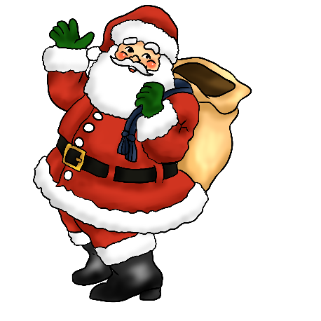
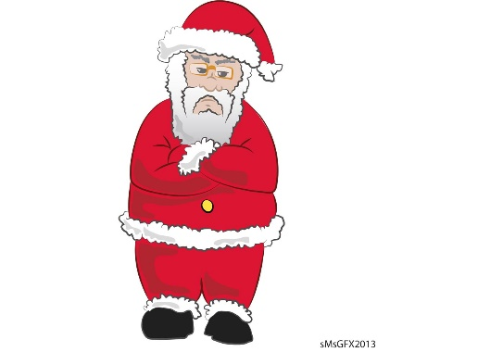
Ergonomics at work, home, etc.
He grew more frustrated and yelled “I cannot keep doing this all in one night. One more elf injury this year and Christmas would not have happened. I absolutely cannot miss work – the world relies on me.” Could automate, but then have unemployed elves.
Santa is not alone. He needs to learn to identify ergonomic opportunities, say no, to delegate, to plan, find activities to reduce his stress, maybe even jump on a treadmill here and there...and practice moderation……. with the cookies.

Slide 8
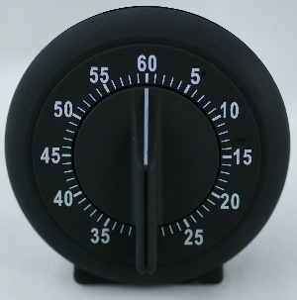
Is this Santa story time or Ergonomics?
*Recognize even Santa is sick of COVID – smile more, say please and thank you
*Fabricate adjustable workstations for the elves
*Listen to your body. If it feels like you need a break or could use a good stretch – do it.
*After engineering out ergo concerns, evaluate task variation or job rotation
*Take time off to perform DIFFERENT tasks
*Promote routine stretching – any stretching

Slide 9
Is this Santa story time or Ergonomics?
Yes
*Spread work out throughout the year
*Get a smaller bag or a container with improved coupling
*Upgrade the sleigh seat to an adjustable chair with appropriate support
*Put handles and non-slip surfaces on the sleigh
Never forget:
The Next Posture is the Best Posture

Slide 10
Progression of an Injury
Hassle (How do you know?)
↓
Discomfort → Pain
↓
Injury

Slide 11
Ergo Glasses
What the heck am I looking for?
Don’t buy just because it says “Ergo”
Spend the money! Buy the right product the first time.
Talk to Vendors about trials. Check the warranty.
Adjustability. Educate yourself how to adjust.
Ask the experts. #WristRests
Do I need to do this? Root cause analysis.

Slide 12
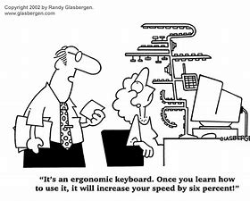
Ergonomic Product Sales Department

Slide 13
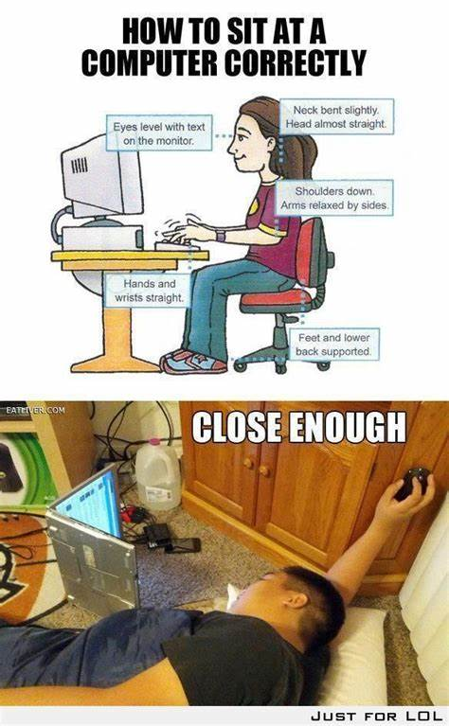
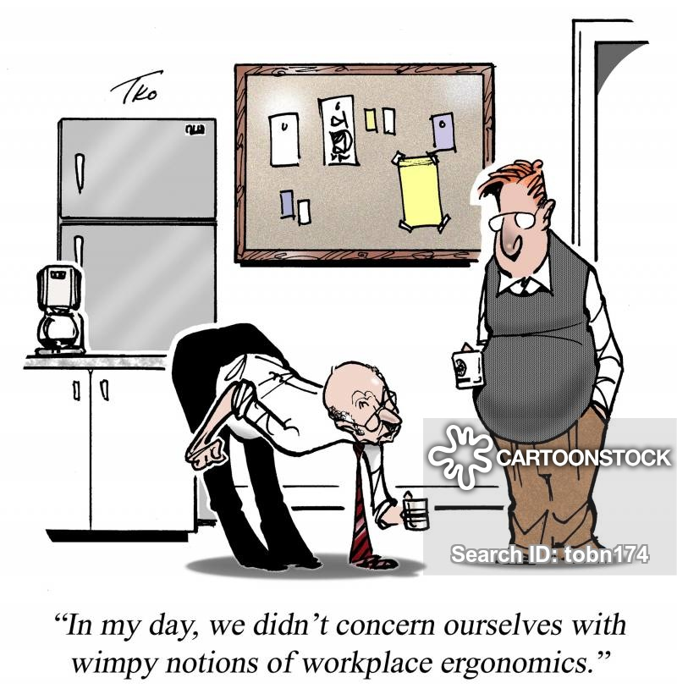

Slide 14
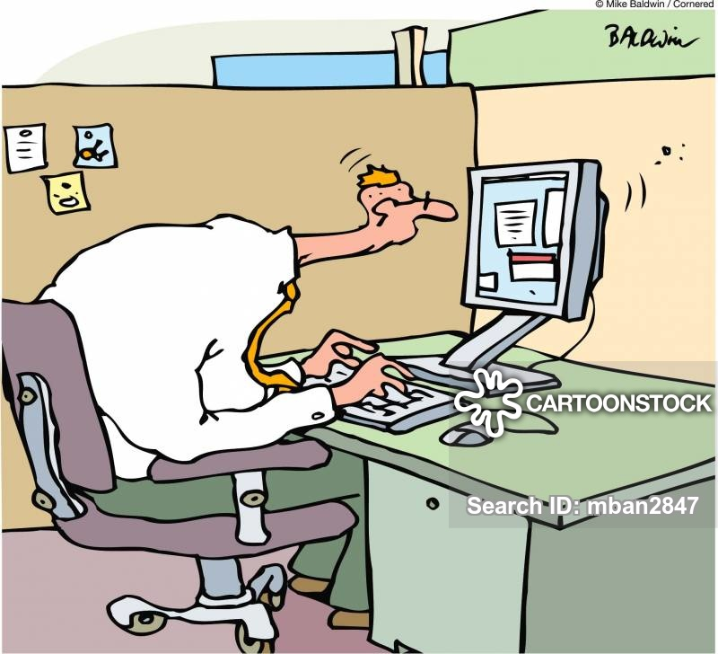
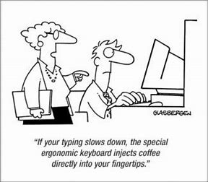

Slide 15
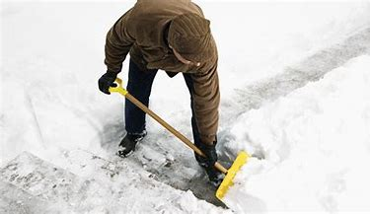
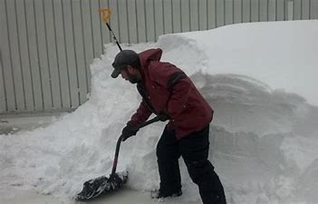
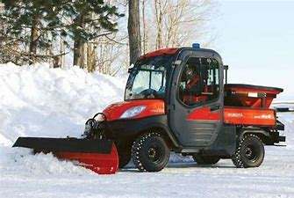
Shoveling Snow

Slide 16
Shoveling Snow
Every year there are over 12,000 reported injuries from snow shoveling, with 34.3% due to musculoskeletal overexertion by the back.
16.5% decrease in forces with bent handled shovel AND, working in a more upright posture = Ergonomic win.
Older? Yes. Common Task? No. Superman? No.
Rest Breaks. Breathe. Be Realistic. Rotation. Need to?
Hire the neighbor kid ambitious enough to do it

